Slide 1
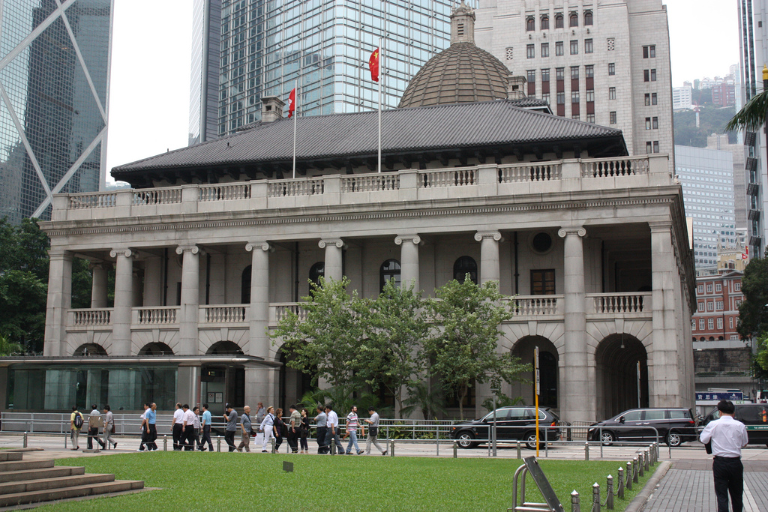
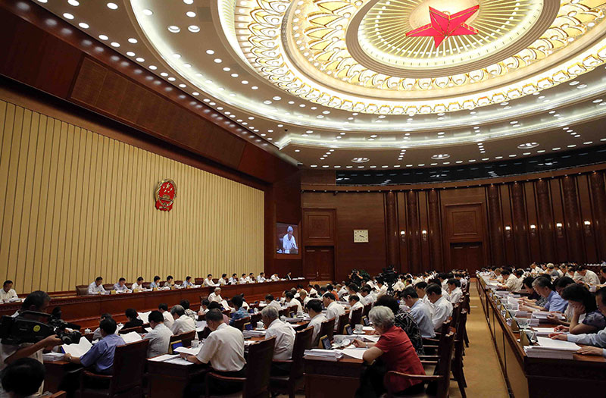
Interpretation of the Basic Law

Slide 2
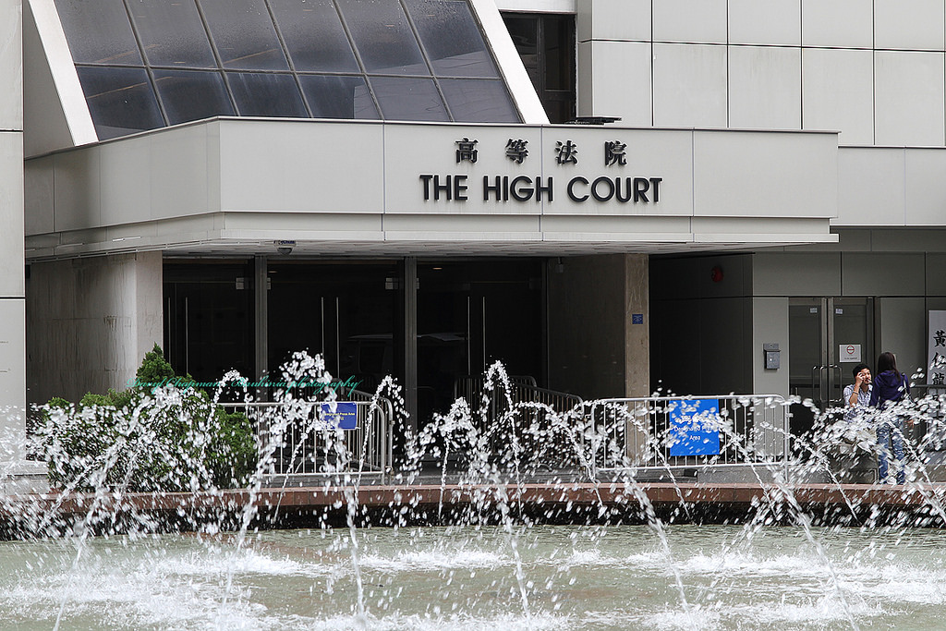
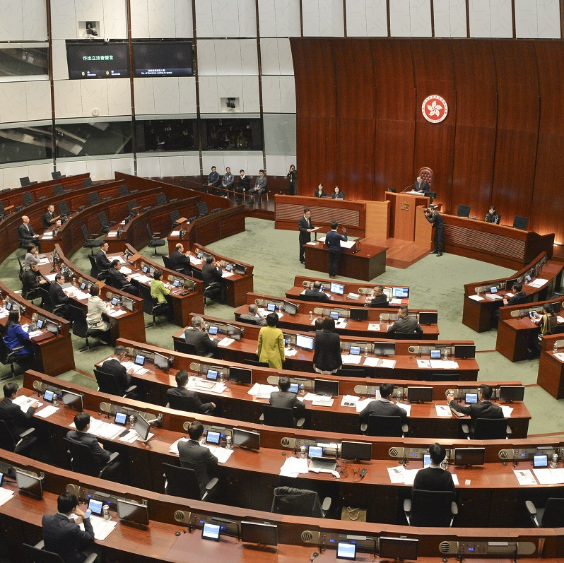
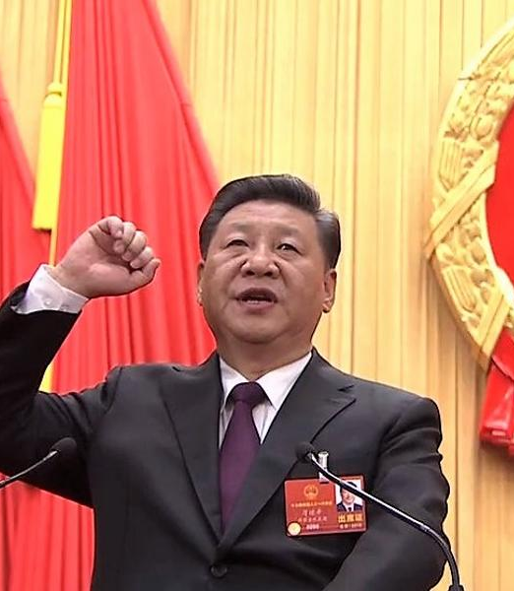
「Law」

Slide 3
What is Rule of Law?

Slide 4
The definition of Rule of Law
The law has the supreme status
Public power is defined and restricted by law
Human rights and freedoms are protected by law.
Independent courts settle disputes fairly and impartially

Slide 5
The four levels of Rule of Law
High
Low
Justice through Law
Limitation from Law
Regulation by Law
Existence of Law

Slide 6
Existence of Law (Level One)
This is the foundational level.
There must be laws covering major areas of human activities and these laws can satisfy some basic requirements
The law will be served as guidelines
The legal provisions are open and clear, and criminal liability has no retroactive effect.

Slide 7
Regulation by Law (Level Two)
The government uses the law as the major governing tool, and government officials are ruling in accordance with the law.
Public order is maintained by the law, citizens in general are willing to obey the law, and disputes between people can be resolved peacefully in accordance with legal procedures.
Lack of effective limitation mechanism, it is difficult to prevent the abuse of public power

Slide 8
Limitation from Law (Level Three)
Powers are effectively and adequately constrained by the laws
For example: Independent judiciary ➔ Juridical Review ➔ Preventing the government from executing unconstitutional decisions (i.e.: violation of the Basic Law) ➔ Check on executive powers ➔ Prevent abuse of powers

Slide 9
Justice through Law (Level Four)
Law is set for justice
The fundamental rights are protected by the law, ranging from procedural rights, civil rights, political rights, social and economic rights and the right to civic engagement.

Slide 10
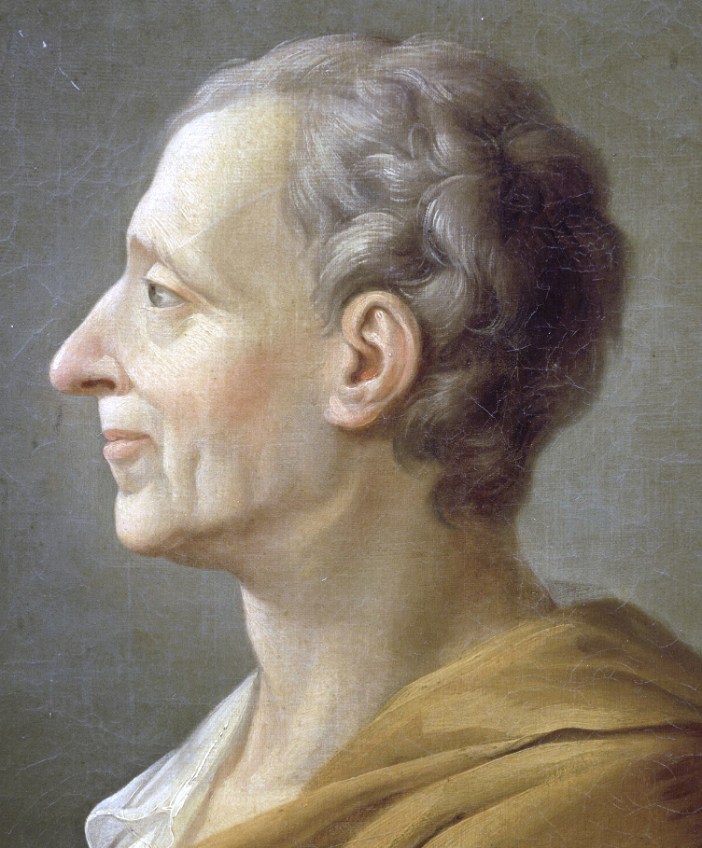
Separation of powers
Montesquieu- The Spirit of the Laws
When administrative power, legislative power, and judicial power cannot be separated, but are controlled by the same person, fear will breed and freedom will disappear.

Slide 11
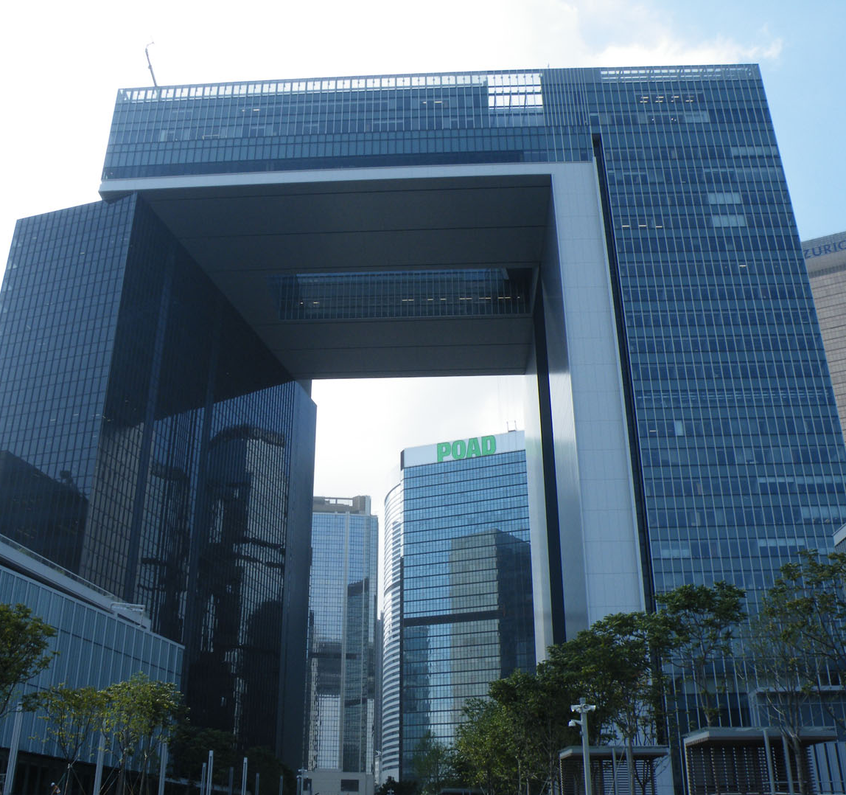
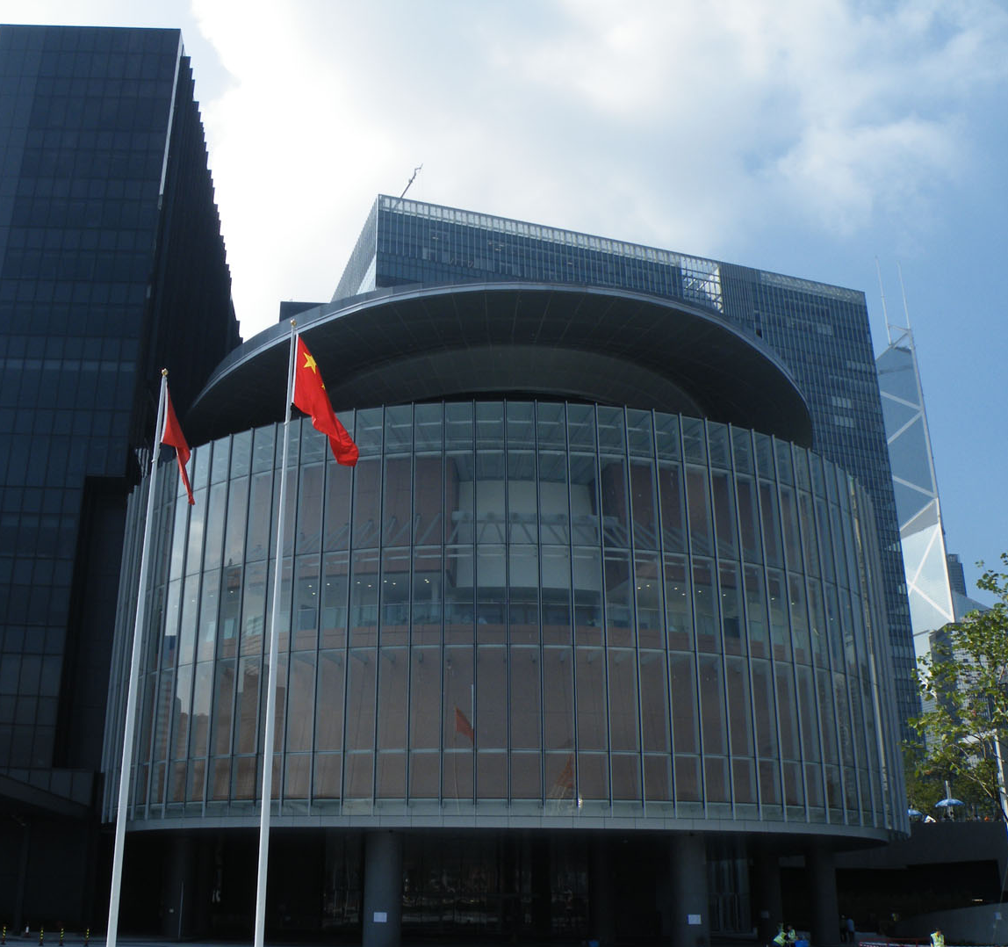
Separation of powers
Public power is separated into administrative power (Hong Kong government), legislative power (Legislative Council) and judicial power (courts at all levels)
Three powers all enjoy equal status, which can effectively check and balance each other.

Slide 12
Judicial Independence
This is the cornerstone of the Rule of Law.
The judiciary must be able to adjudicate independently and impartially in accordance with the law, regardless of the background of the litigants and is free from political pressure.

Slide 13
One Country, Two Systems
 | Mainland China | HKSAR
Political System | One-party ruling Legislature sovereignty | Multi-party system separation of powers
Legal System | Socialist legal system Statutory law | Common law system Case law and statutes coexist
Notes:
在主權移交後，香港可以繼續保留自己的政治制度、法律體系、經濟政策、金融事務、管治制度以及對外關係

Slide 14
Law
Interpretation

Slide 15
Hairstyles in School

Slide 16
Hairstyle in school rules
No fanciful haircut is allowed. Hair must not be tinted or dyed.

Slide 17
Student A

Slide 18
Student B

Slide 19
Student C

Slide 21
Why we need to “interpret” the law?
Vague wording in provisions
Changes in the time and advancement in science and technology will alter the meaning of a same word
No legislator can foresee all the future events

Slide 22
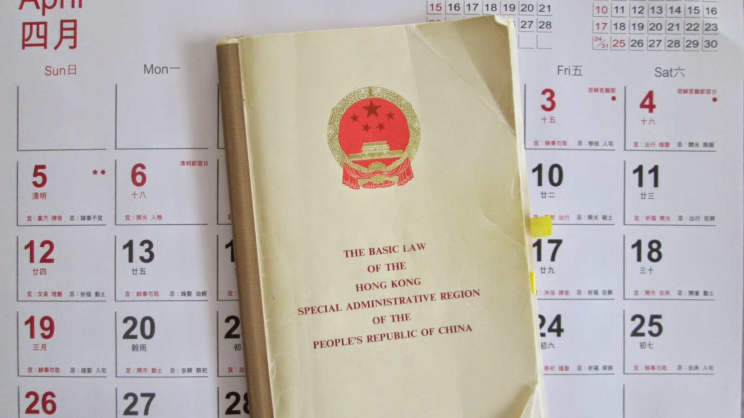
Who can interpret Hong Kong’s provisions?
 | 《The Basic Law》 | Other laws （Criminal Law, Civil Law）
Interpretation institutions | Hong Kong court NPCSC | Hong Kong court
Final power to interpret | NPCSC | The Hong Kong Court of Final Appeal
Notes:
釋法性質: 司法解釋 VS 立法解釋

Slide 23
Interpretation of the Basic Law by the NPCSC

Slide 24
Source of Power: 《The Basic Law》 Article 158
The power of interpretation of this Law shall be vested in the Standing Committee of the National People's Congress.
If the courts of the Region, in adjudicating cases, need to interpret the provisions of this Law concerning affairs which are the responsibility of the Central People's Government, or concerning the relationship between the Central Authorities and the Region, … (the courts shall) seek an interpretation of the relevant provisions from the Standing Committee of the National People's Congress through the Court of Final Appeal of the Region.
…Judgments previously rendered shall not be affected.

Slide 25
What is the difference between interpretation of
the Basic Law by the NPCSC and
by Hong Kong’s courts?
 | Hong Kong’s Courts | NPCSC
Scope of interpretation | Can't exceed the meaning that the text can carry | Allow supplementation, clarification
Nature of interpretation | Judicial interpretation | Legislative interpretation

Slide 26
Interpretation of school rules

Slide 27
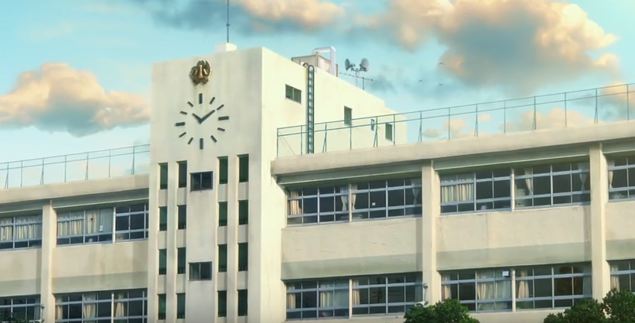
Charter of school rules
The power of interpretation of school rules shall be vested in Principal.
All school affairs are regulated by school rules.
The class teacher can interpret the school rules on his own.
However, when the class teacher is dealing with the school policy, he needs to ask the principal to interpret the school rules and final decision shall be made based on the principal’s interpretation.

Slide 28
Good morning
At the beginning of first lesson of each day, students must stand up and say ”good morning, teacher."

Slide 29
Doraemon yawned when he saluted Miss Chan, but in the end he was also able to finish the sentence ”Good morning, teacher."

Slide 30
Doraemon may be too tired, it doesn’t matter!
Doraemon deliberately disrespected Miss Chan!

Slide 31
Did Doraemon violate the school rules?
Good morning
At the beginning of first lesson of each day, students must stand up and say ”good morning, teacher."

Slide 32
The principal interpreted the rules!
Doraemon! In salute, students must say the words “Good morning, teacher” completely and accurately in a serious manner and tone, otherwise it is a violation of the school rules! Now I will give you a major demerit as penalty.

Slide 33
How is the school rule changed after the interpretation?
 | Before the interpretation | After the interpretation
The content | At the beginning of first lesson of each day, students must stand up and say ”good morning, teacher." | In salute, students must say the words “Good morning, teacher” completely and accurately in a serious manner and tone, otherwise it is a violation of the school rules! Now I will give a major demerit to you as penalty.
Manner, Tone | Not mentioned | Serious
Consequence | Not mentioned | a major demerit as penalty

Slide 34
Notice： The principal interpreted
the school rules based on what principles?
Scope of interpretation:
Can't exceed the meaning that the text can carry
Allow supplementation, clarification

Slide 35
Notice: How to start the procedure of
the interpretation of school rules from the principal?
Class teacher seeks an interpretation of the school rule from the principal
The principal can interpret on his own

Slide 36
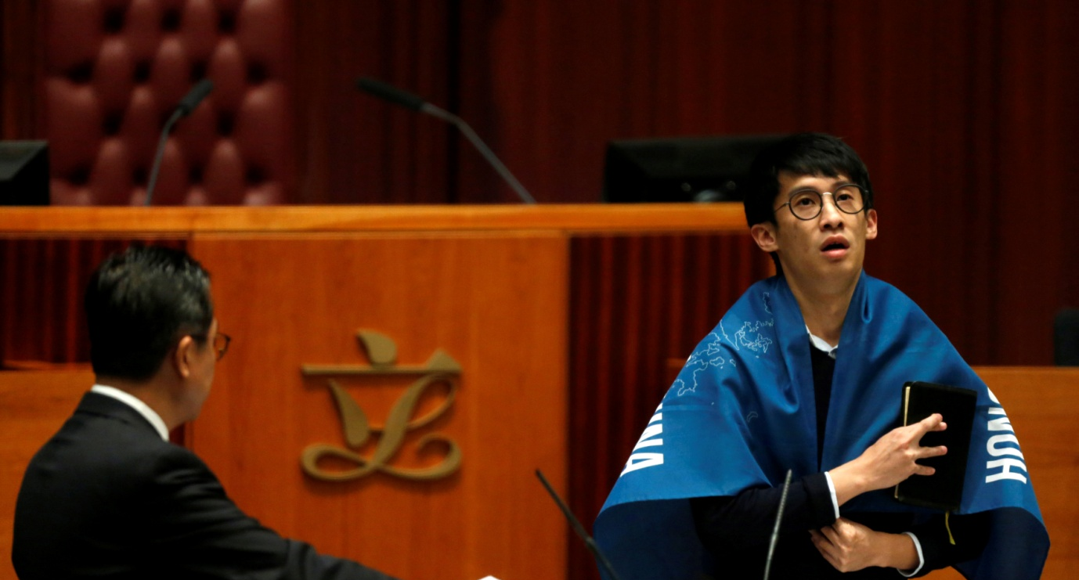
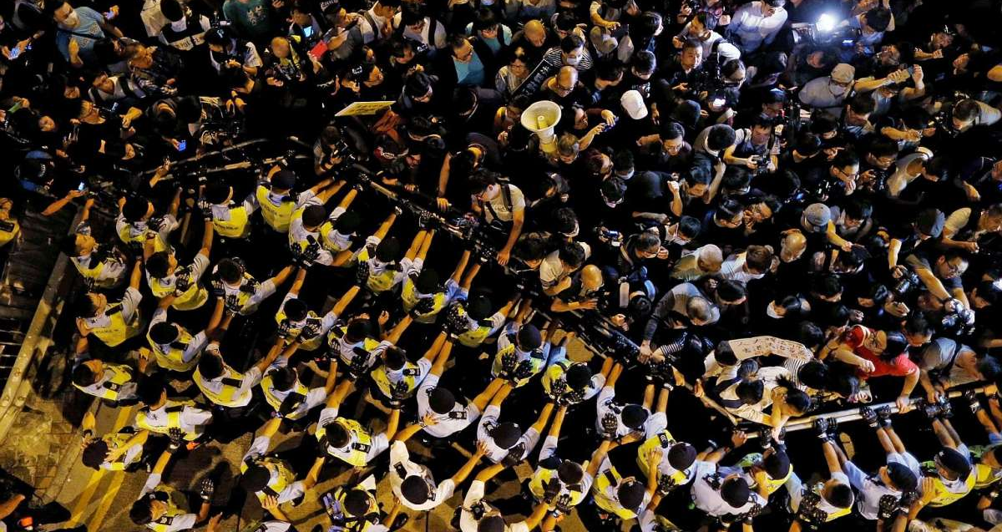
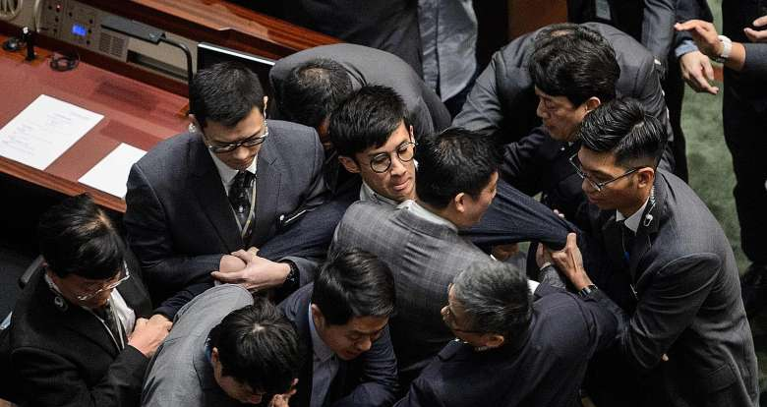
The introduction of “Hong Kong Legislative Council oath-taking controversy”

Slide 37
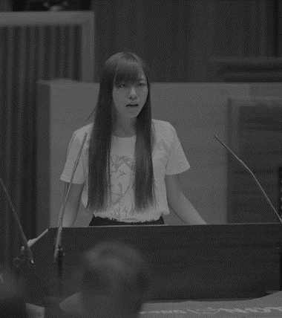
Baggio Leung Chung-hang | Yau Wai-ching
Leung inserted his own words related to “Hong Kong Nation” into the official script He mispronounced China as "Jee-na", a term considered derogatory since the Second Sino-Japanese War He showcased a flag of「HONG KONG IS NOT CHINA」 | Yau mispronounced China as "Jee-na", and "People’s Republic of China" as "people’s re-fuxking of Jee-na” She showcased a flag of「HONG KONG IS NOT CHINA」

Slide 38
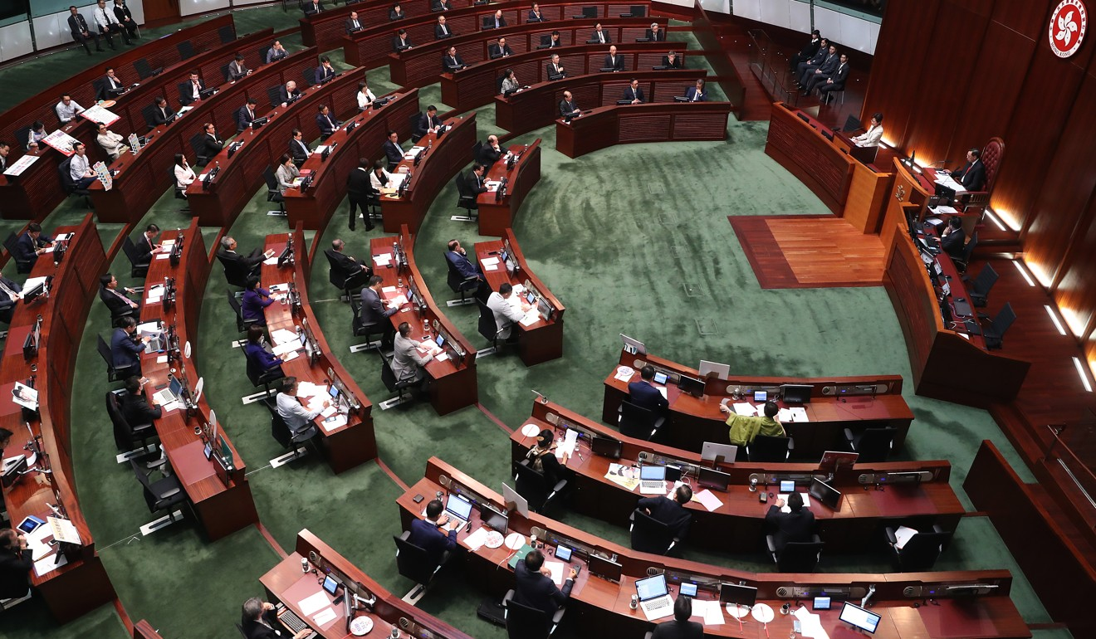
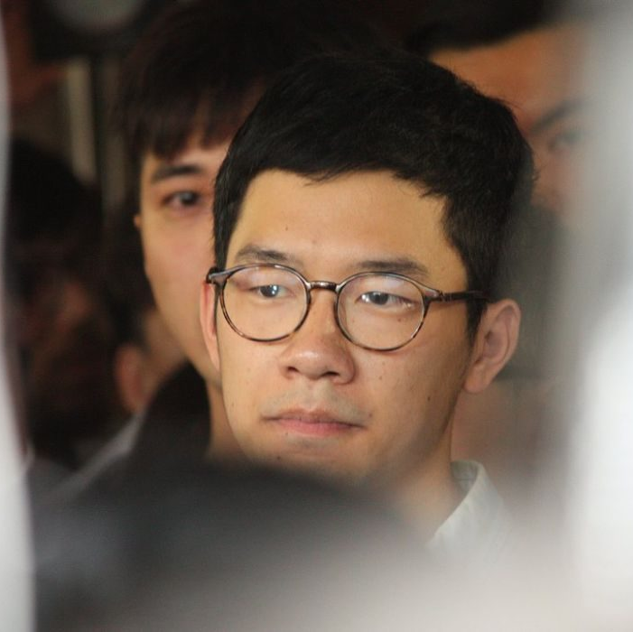
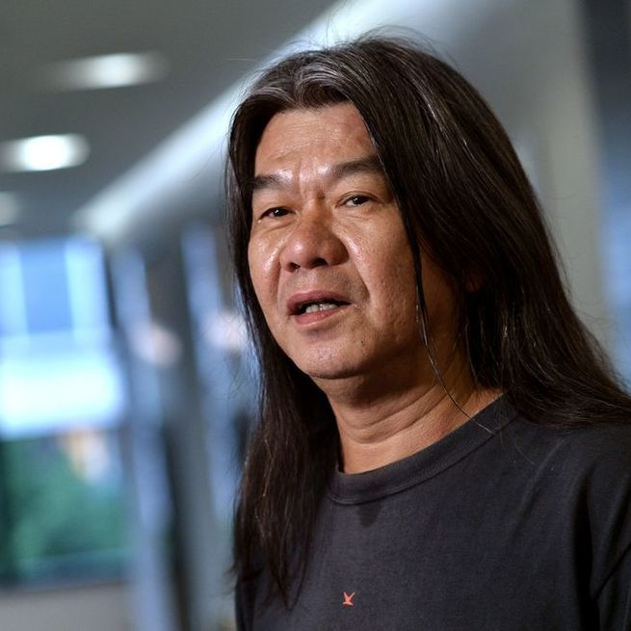
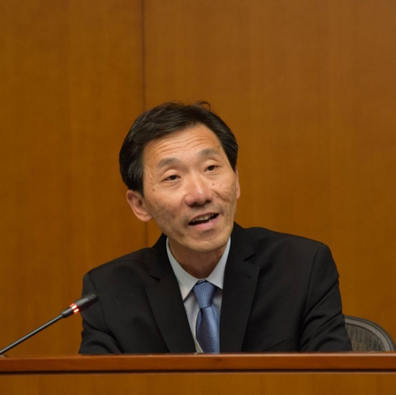
Nathan Law Kwun-chung
Law made an opening statement saying that the oath ceremony had already become the "political tool" of the regime.
When taking the oath, Law also rose his intonation on the last word of the phrase “HKSAR”.
Lau Siu-lai
Lau said the words required but made her protest by saying them extremely slowly and taking twelve minutes to complete the oath.
Leung Kwok-hung
Leung held up a yellow umbrella, and chanted slogans demanding democracy and the chief executive’s resignation.
Edward Yiu Chung-yim
Yiu added the words "safeguarding the institutional justice, fighting for universal suffrage, serving for the sustainable development of Hong Kong" in his oath twice

Slide 39
Hong Kong law relating to the Legislative Council’s oath ceremony
 | 《Basic Law》 Article 104 | 《The Oaths and Declarations Ordinance》 Article 16-21
Content | No prescribed form and disqualification | Prescribed form, if rejected or ignored, may be disqualified
The power of final interpretation vested in | NPCSC | The Hong Kong Court of Final Appeal

Slide 40
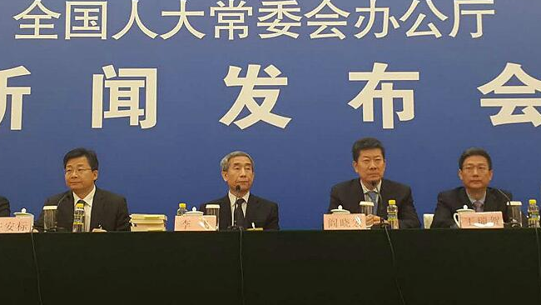
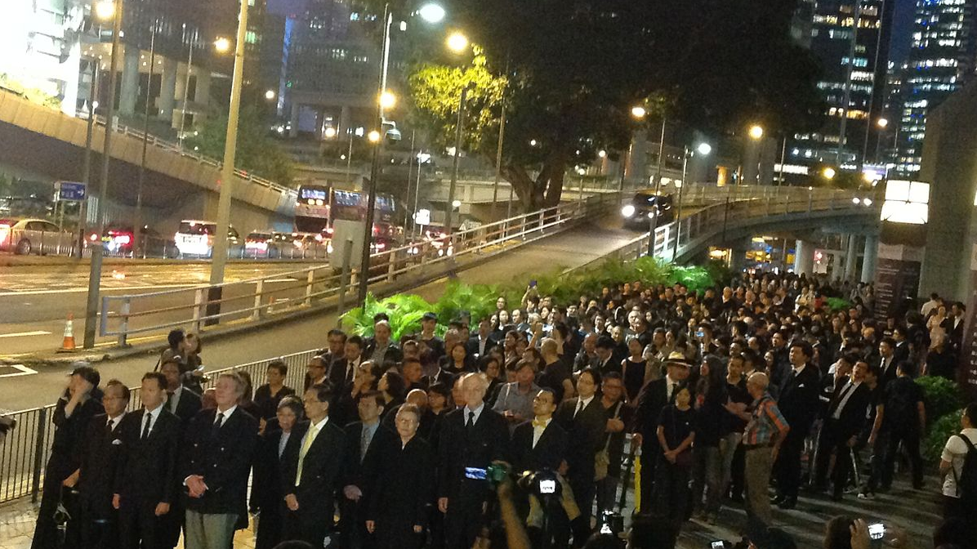
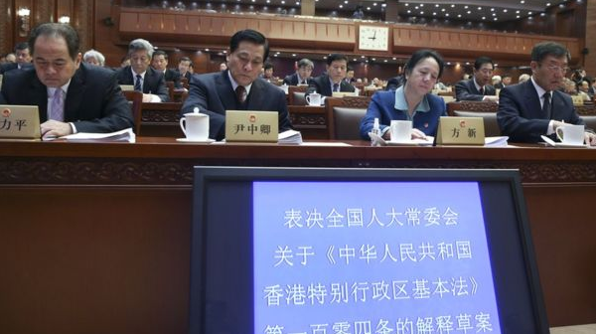
The fifth interpretation of
the Basic Law

Slide 41
 | The Oaths and Declarations Ordinance | The Basic Law Article 104 | The fifth interpretation
The requirement of oath taking? | As soon as possible after the commencement of his term of office | He shall take his oath in accordance to law, that he will uphold the Basic Law of the Hong Kong Special Administrative Region of the People’s Republic of China, bear allegiance to the Hong Kong Special Administrative Region of the People’s Republic of China”. | An oath taker must take the oath sincerely and solemnly, and must accurately, completely and solemnly read out the oath prescribed by law, the content of which includes “will uphold the Basic Law of the Hong Kong Special Administrative Region of the People’s Republic of China, bear allegiance to the Hong Kong Special Administrative Region of the People’s Republic of China”.
Disqualification? | Any person who declines or neglects to take an oath duly requested which he is required to take by this Part, shall— (a) if he has already entered on his office, vacate it, and (b) if he has not entered on his office, be disqualified from entering on it. | Not mentioned | An oath taker who takes the oath in a manner which is not sincere or not solemn, shall be treated as declining to take the oath. The oath so taken is invalid and the oath taker is disqualified forthwith from assuming the public office specified in the Article.
Commissioner’s power? | Commissioned by the secretary of Legislative Council or the chairperson of Legislative Council | Not mentioned | 1. Commissioner can determine the oath as invalid 2. No arrangement shall be made for retaking the oath.

Slide 42
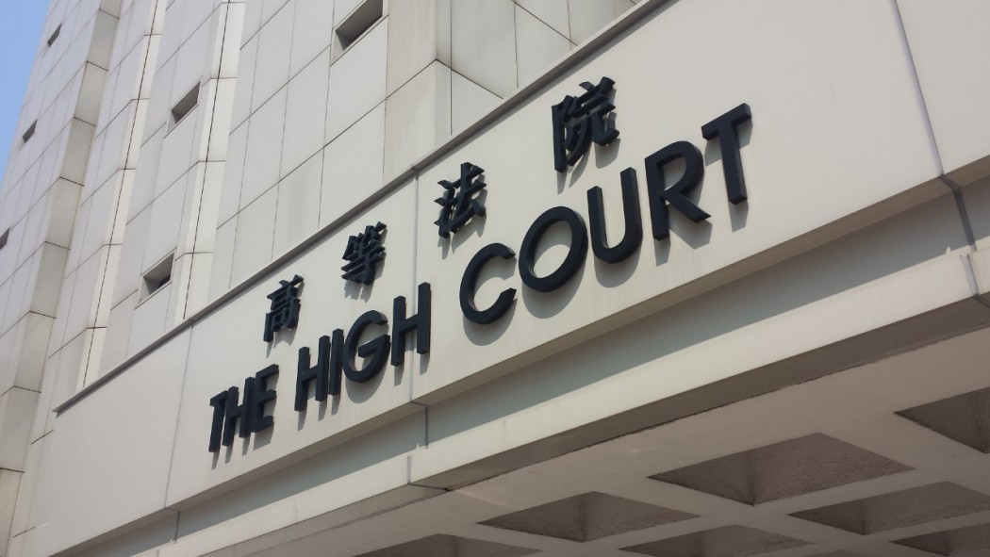
The final judgment after two Juridical Reviews:
Baggio Leung Chung-hang, Yau Wai-ching, Leung Kwok-hung, Nathan Law Kwun-chung, Edward Yiu Chung-yim, and Lau Siu-lai’s oath were invalid, they were disqualified and ousted as legislative councilors。

Slide 43
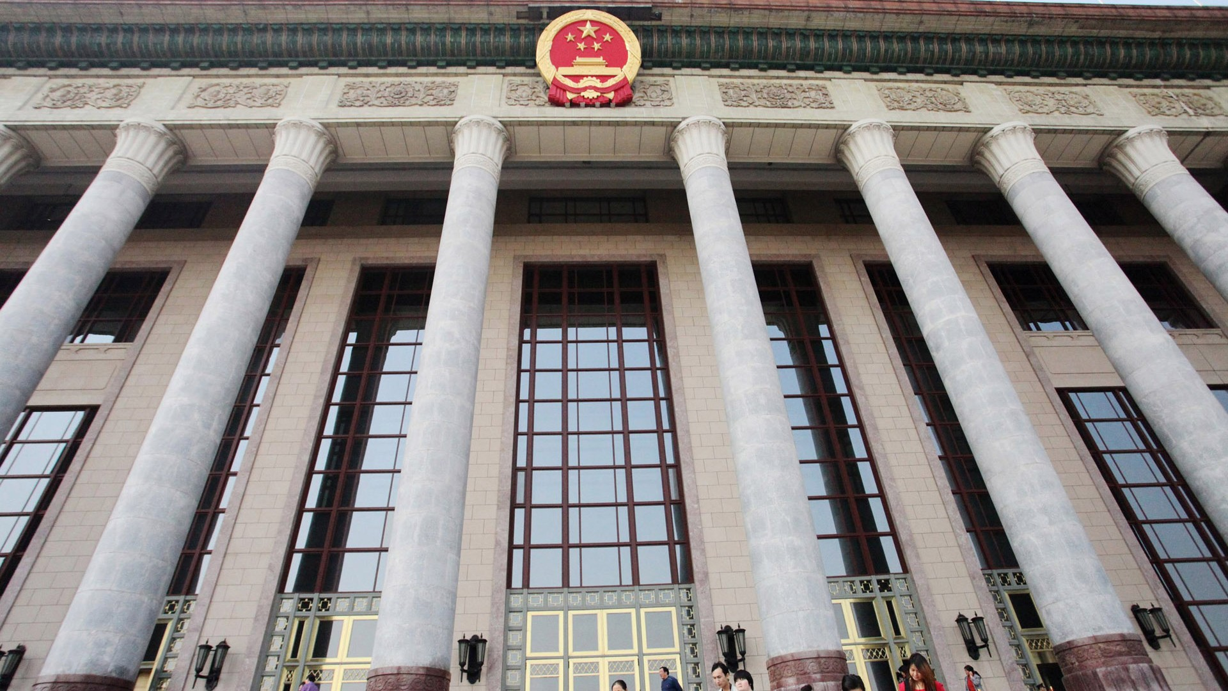
Is the fifth interpretation similar to the principal’s interpretation of the school rules?
Do you think that the interpretation of the NPCSC is in line with the rule of law?

Slide 44
Disputes over the fifth interpretation (1)
Is the Standing Committee of the National People's Congress interpreting or amending the Basic Law?
The consequences of invalid oath of invalidity and the affidavit are under the Oaths and Declarations Ordinance.
Has the power of the Court of Final Appeal been narrowed?
Does it align with the principle of separation of powers? Which branch of the three powers is the NPCSC?

Slide 45
Disputes over the fifth interpretation (2)
How to verify the standards of "sincerity" and ”solemnity" in the law?

Slide 46
Disputes over the fifth interpretation (3)
The Standing Committee of the National People's Congress had interpreted the law during the trial of Court of First Instance of the High Court of the Hong Kong Special Administrative Region. Had it affected Hong Kong's judicial independence?
In the case of Leung & Yau, both the Court of Appeal and the Court of Final Appeal made judgments based on the interpretation of the NPCSC.

Slide 47
Conclusion
People may have different understandings of the true meaning regarding the provisions in the Basic Law.
Both the Hong Kong courts and the Standing Committee of the National People's Congress have the power to interpret the Basic Law, while the latter have the final power of interpretation.
However, the Hong Kong courts have the final power to interpret other laws in Hong Kong.
The Standing Committee of the National People's Congress had interpreted the law during the trial, which may put pressure on the Hong Kong courts and affect judicial independence.
As a legislative body, the Standing Committee of the National People‘s Congress has not only enacted laws but also interpreted laws. It may contradict with the principle of separation of powers and thus fail to achieve the purpose of checks and balances.

Slide 48
Q&A Session
Notes:
Maybe just teach one question
Hard to interact in a large hall
Need more guidance questions
More connection of the concepts to the question
More on rights protection?
Level 1 For less able students: Use 5th Interpretation to illustrate there is controversy - tell them “Interpretation is complicated!”
Level 2 For more able students: tell them “why interpretation is complicated”
Level 3 Even more able ones: “Why interpretation harm Rule of Law”
Hard questions: show answer (use point-form)
Audience perspective: sth for them to take-away
Key message in the conclusion

Slide 49
HKU Law Programmes for JUPAS applicants (The knowledge and skills we learn are relevant in any field)
HKU
Years
Intake
Selection
Faculty
LLB
4 yrs
95-100
DSE only
Law
BA Literary Studies & Law
5 yrs
25
DSE only
Law
BBA(Law)
5 yrs
70-80
Also Interview
Business
BSS(Government & Law)
5 yrs
60-70
Maybe Interview
Social Science

Slide 50
2017-18 Average JUPAS (HKDSE) Results (5**=7; 5*=6; 5=5; 4=4; 3=3; 2=2; 1=1)
HKU
English
Chinese
Maths
Liberal Studies
4 core subjects & best 2 electives
LLB
6.182
5.610
5.558
5.714
5.836
BA Literary Studies & Law
6.407
5.889
5.074
5.519
5.827
BBA(Law)
6.188
5.813
5.859
5.906
6.017
BSS(Government & Law)
6.279
5.698
5.488
5.744
5.888

Slide 51
Strategy for JUPAS (HKDSE) Applicants (Apply for Law whether you want to be a lawyer or not)
The JUPAS system will send you to the FIRST programme that you meet its criteria
E.g. 4C+2E = 42
1st choice
2nd choice
3rd choice
JUPAS outcome
Medic
Law
Medic
Science
(You won’t go to 2nd/3rd choice even if you also meet their criteria)
● If your 4C+2E = 34 or above, good chance of getting into Law
● Actual minimum varies from year to year, around 33 or 34
● When you re-prioritize, put us as FIRST choice

