Slide 1
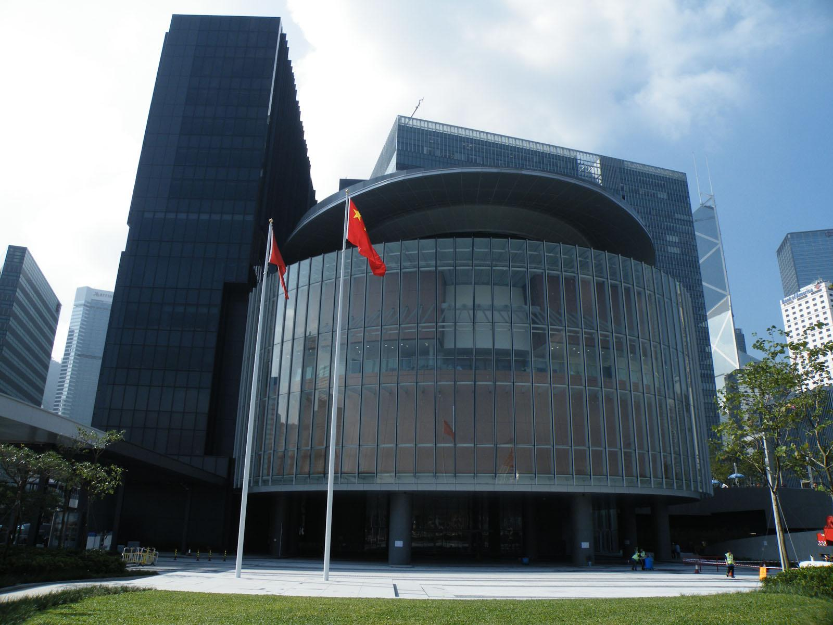
Separation of Powers in Hong Kong

Slide 2
What is Separation of Powers?

Slide 3
Separation of Powers
A state's government is divided into three branches, namely an executive, a legislature and a judiciary

Slide 4
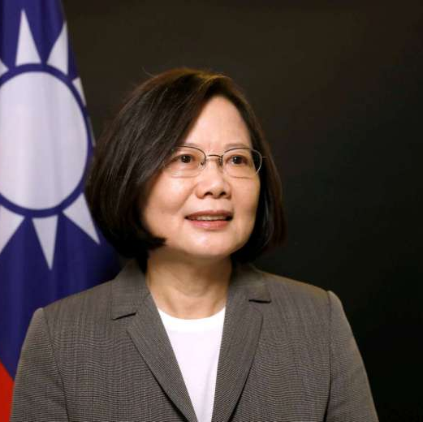
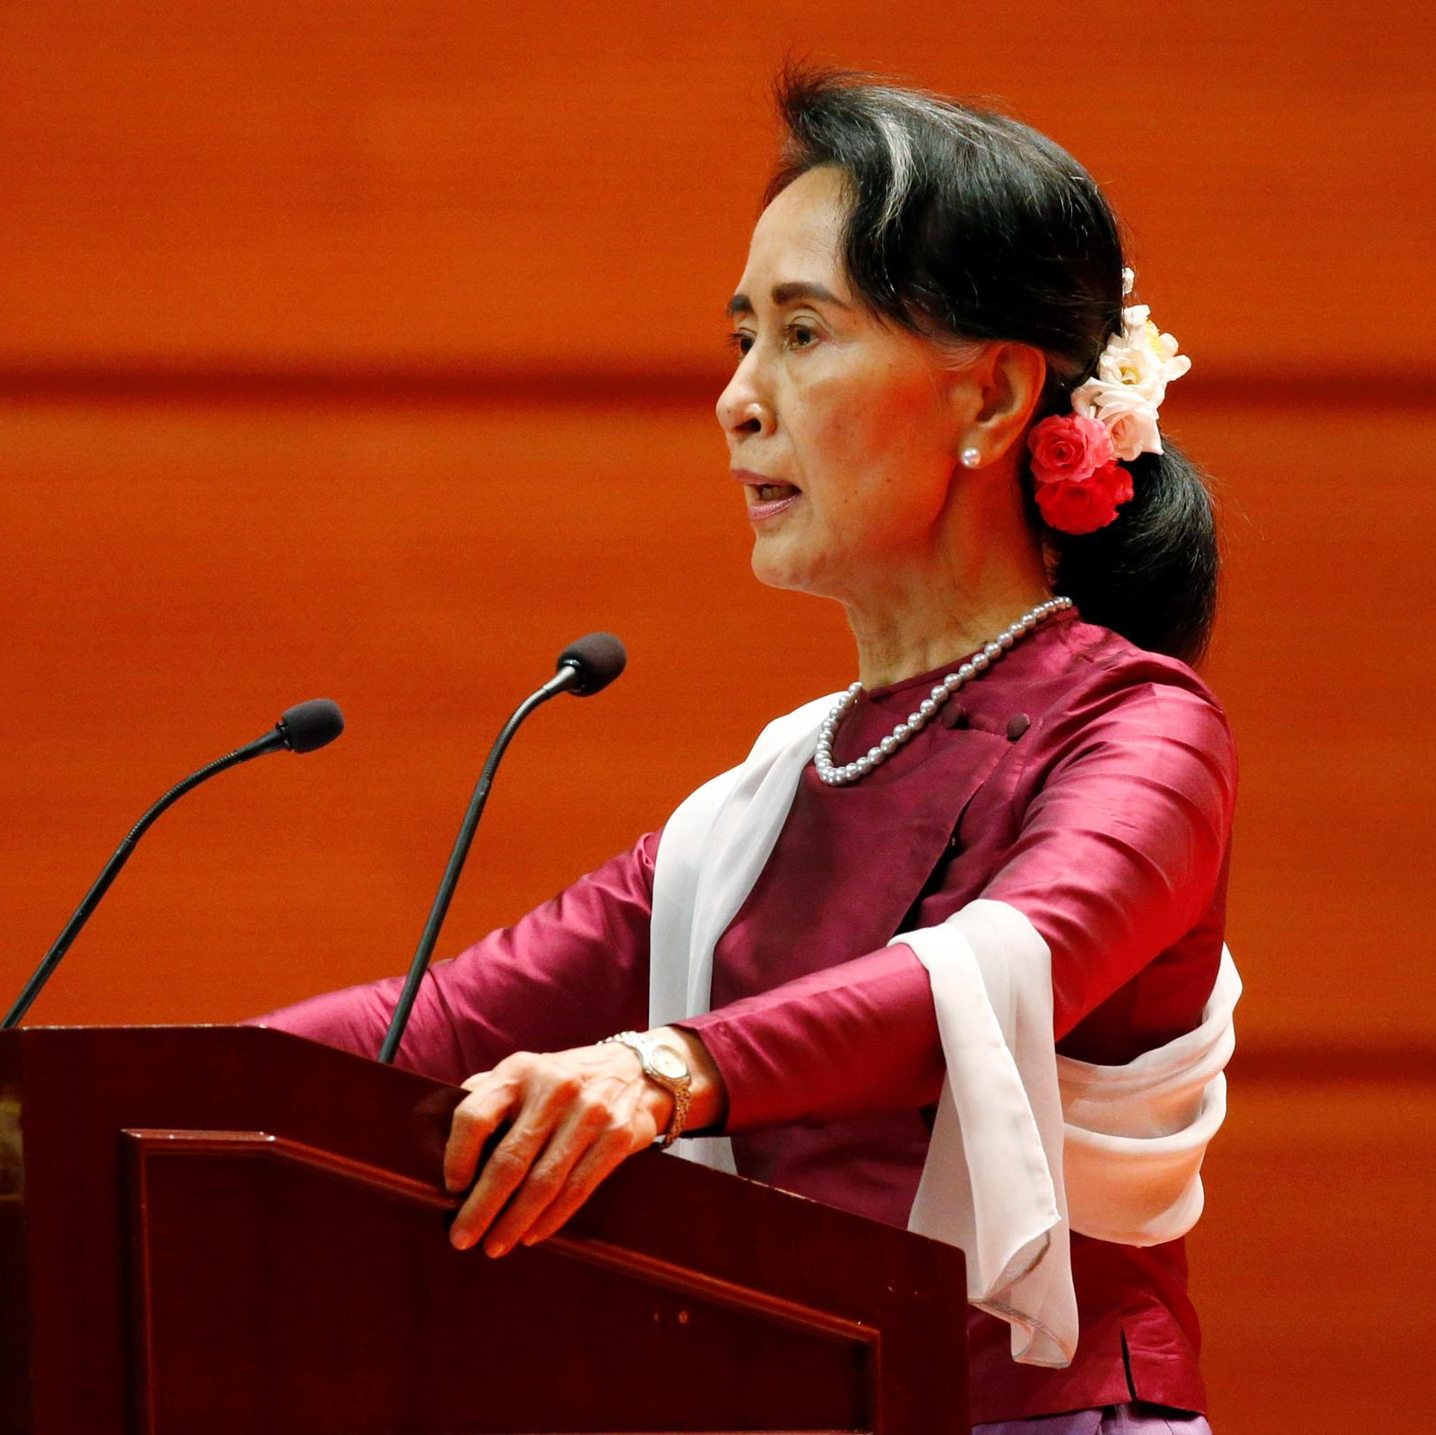
The Executive Branch
In a narrow definition, the word “Government” refers to the executive branch only
Functions of the executive branch include: formulating and implementing policies, implementing laws passed by the Legislature, and providing a wide range of public services

Slide 5
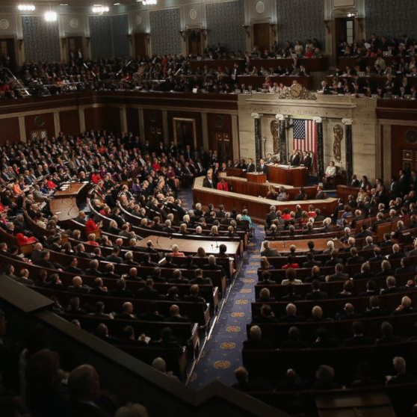
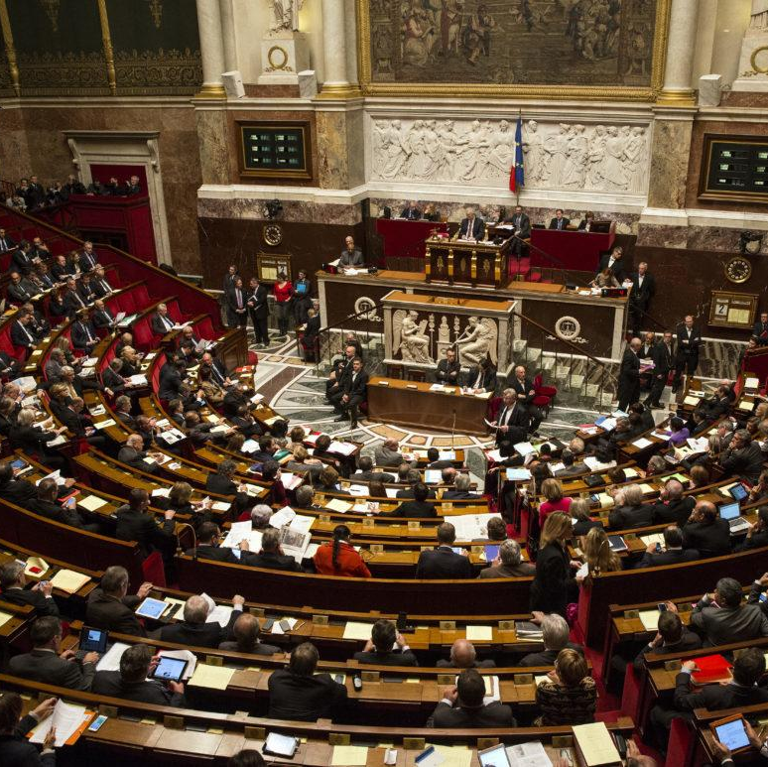
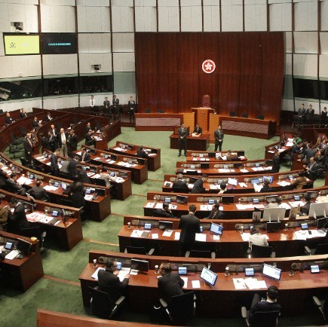
The Legislative Branch
Functions of the Legislature include: formulating and scrutinizing laws, debating different public issues and policies, supervising the operation of the Executive government

Slide 6
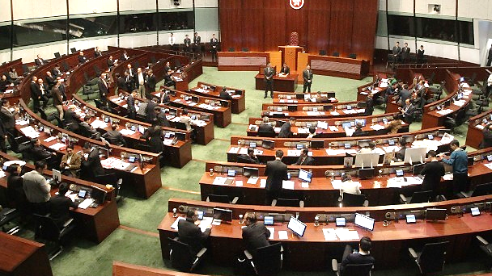
Legislative Council (香港立法會)

Slide 7
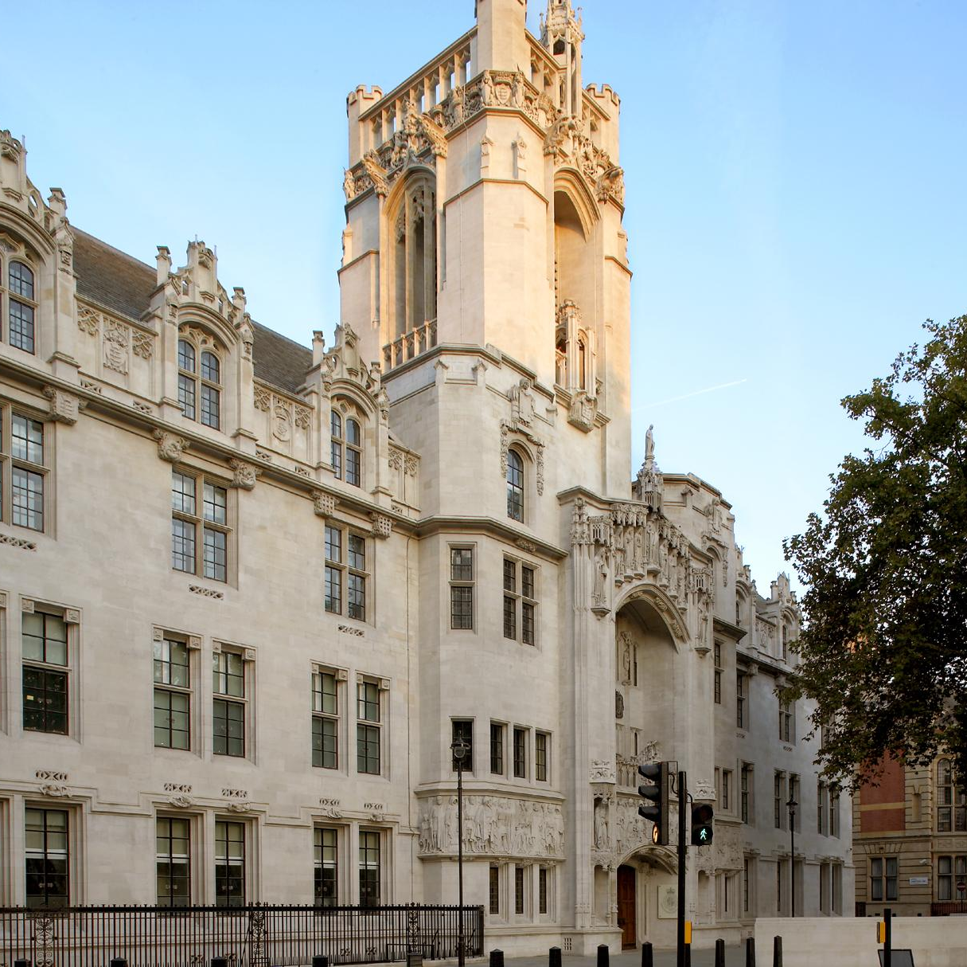
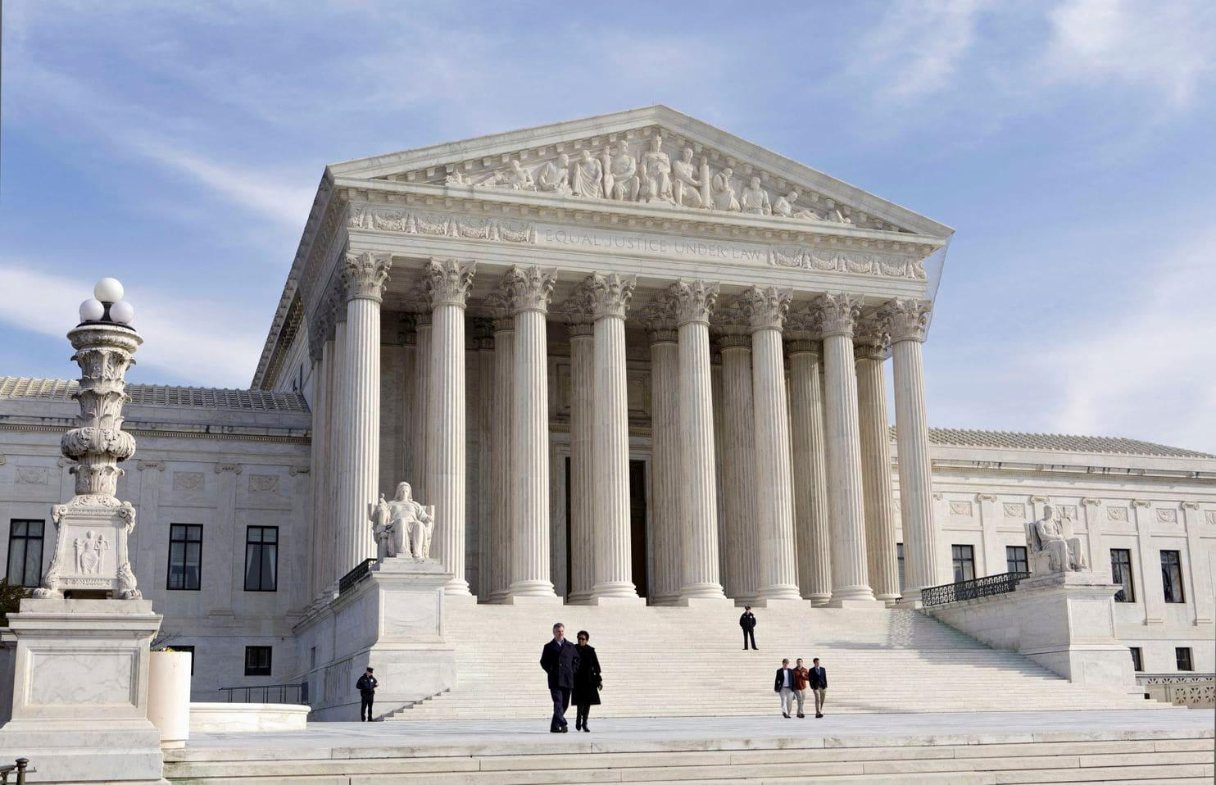
The Judicial Branch
Functions of the Judiciary: try cases and make judgements whether
(i) policies formulated by the Executive Branch; and (ii) the law passed by the Legislative Council have violated the Constitution (which is the Basic Law in Hong Kong)

Slide 8
“Separation of Powers”
The three powers share equal status, and they function independently and thus carry out checks and balances

Slide 9
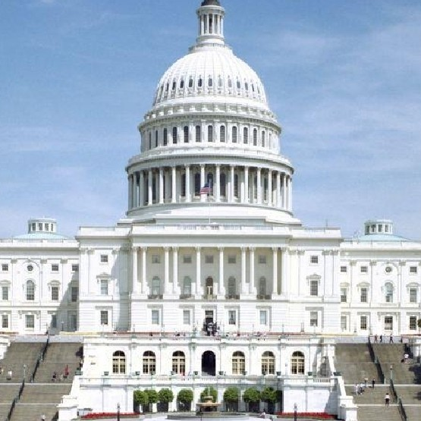
Separation of Powers
Constitution
Specification
Public Authority
Separation
Separation
Separation
Executive Branch
Supervision
Implementation
Basis for rulings
Formulate
Law
Review whether the Constitution has been violated
Judiciary Branch
Legislative Branch

Slide 10
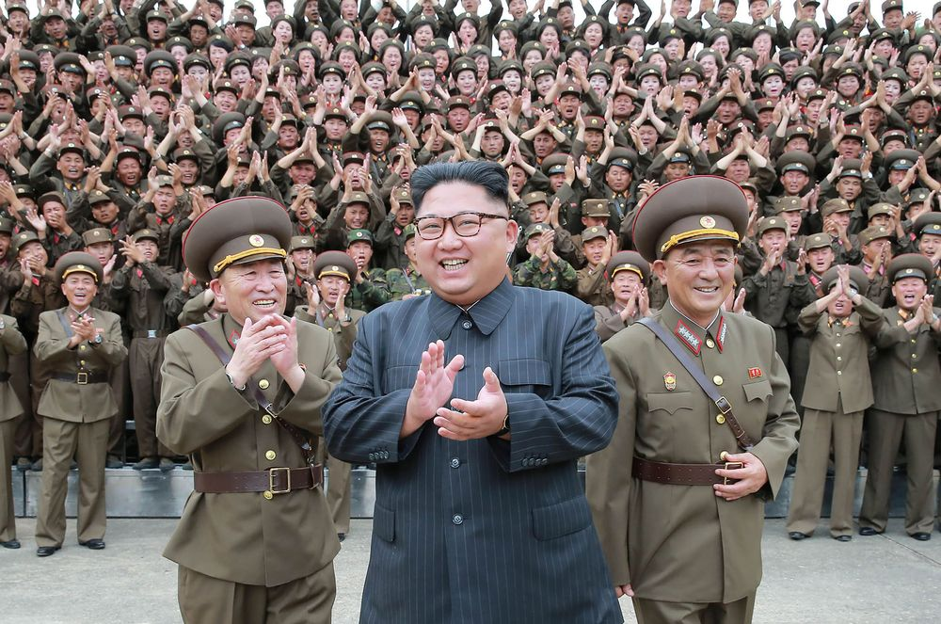
Why separate the three powers?

Slide 11
Separation of powers? No way!
I can rule Russia efficiently only if I own all powers.
Muhammad
Hahaha! Well-said!
If our exercise of power is monitored by others, then how to rule my country?
Putin

Slide 12
Long live Leader Kim!
It is fortunate to have you as our great leader! We don’t need separation of powers!
Kim
Mr.Park
Of course! Plato said so!

Slide 13
“Philosopher King” by Plato

Slide 14
Plato
A country should be ruled by the most intelligent person, and his power should not be subject to any limitation!

Slide 15
What’s your view?

Slide 16
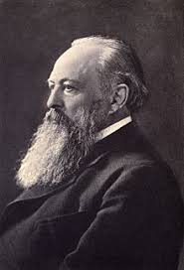
First…
Lord Action:
“Power corrupts. Absolute power corrupts absolutely.”

Slide 17
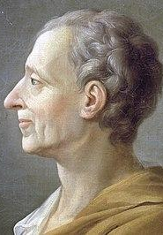
Montesquieu:
“When the legislative and executive powers are united in the same person, or in the same body of magistrates, there can be no liberty; because apprehensions may arise, lest the same monarch or senate should enact tyrannical laws, to execute them in a tyrannical manner.”

Slide 18
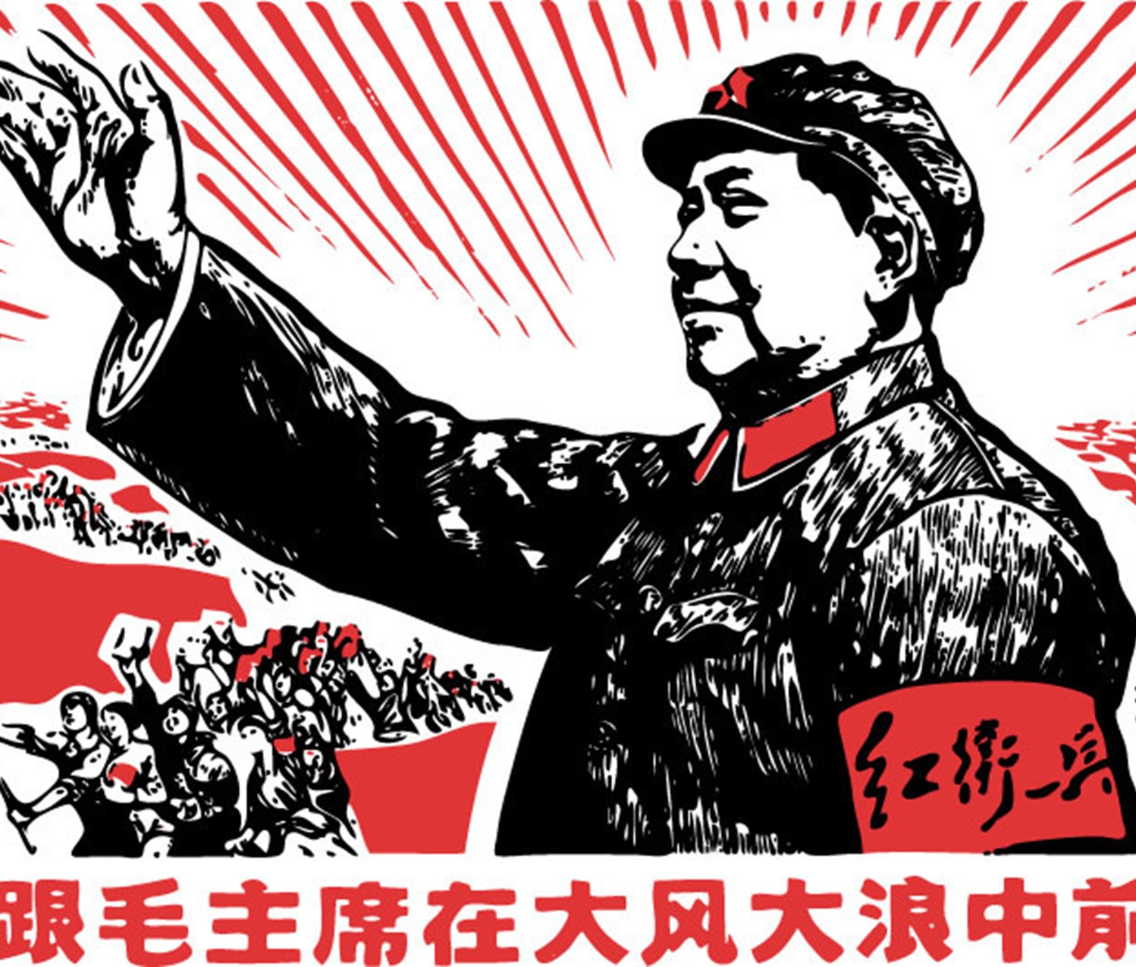
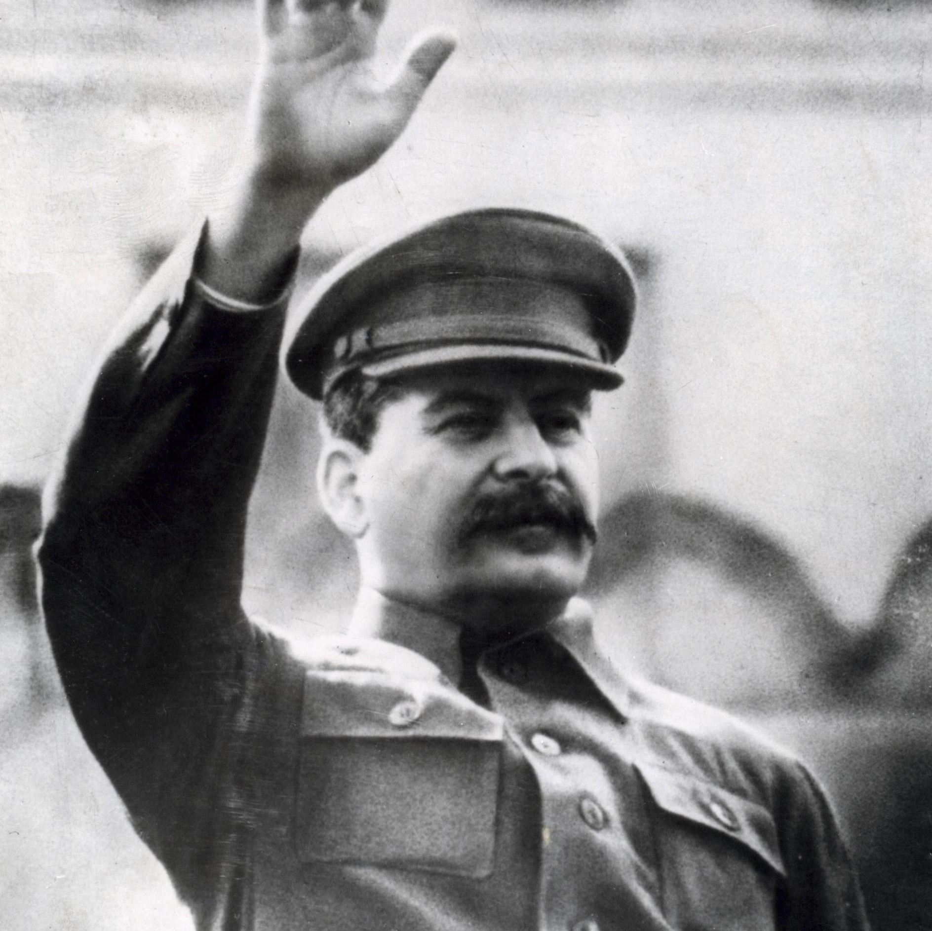
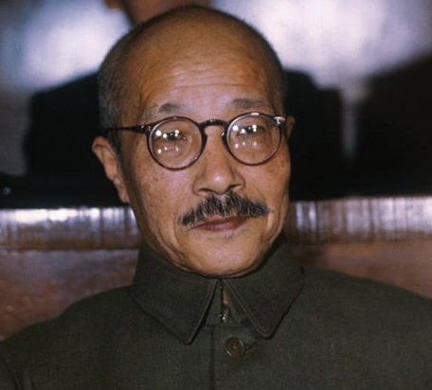
Do you know them?
Mao
Stalin
Hideki Tojo

Slide 20
Millions of people died because of the Great Leap Forward

Slide 21
Consequences when rulers are not properly scrutinized

Slide 22
Former US President Nixon faced pressure from Congress regarding on Watergate Scandal and thus RESIGNED

Slide 23
Trump’s travelling restriction was held ILLEGAL by the court

Slide 24
Failing to get enough support from the LegCo, HK government withdrew the legislation for Basic Law Article 23

Slide 25
Separation of Powers in HK

Slide 26
Most important content of any constitution
Firstly, the relationship between the people and government, i.e. the rights and duties of the people and the government. People can do whatever that are not limited, government can only do what are permitted.
Secondly, the political structure, i.e through what way the governmental powers check and balance each other so that the rights of the people are protected.

Slide 27
Chapter I:
General Principles
Chapter II:
Relationship between the Central Authorities and the Hong Kong Special Administrative Region
Chapter III:
Fundamental Rights and Duties of the Residents
Chapter IV:
Political Structure
1: The CE
2: The Executive Authorities
3: The Legislature
4: The Judiciary
5: District Organizations
6: Public Servants

Slide 28
Chapter V:
Economy
Section 1: Public Finance, Monetary Affairs, Trade, Industry and Commerce
Section 2: Land Leases
Section 3: Shipping
Section 4: Civil Aviation
Chapter VI:
Education, Science, Culture, Sports, Religion, Labour and Social Services
Chapter VII:
External Affairs
Chapter VIII:
Interpretation and Amendment of the Basic Law

Slide 29
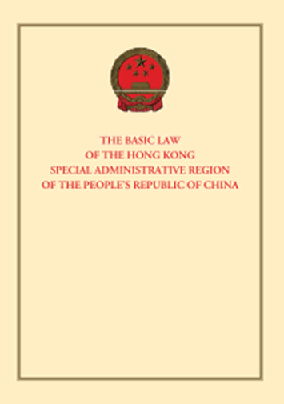
Does HK establish Separation of Powers？
Q: How many times does the Basic Law mention the Separation of Powers?
A. 1
B. 3
C. 5
D. 8

Slide 30
Hong Kong establishes ‘Executive-led’,
not Separation of Powers.
The executive branch must be formed by patriots.
Zhang Dejiang
張德江

Slide 31
Hong Kong doesn’t do ‘separation of powers’. The Chief Executive should have a superior status well above the Three Powers.
Zhang Xiaoming
張曉明
Great!
CY Leung
梁振英

Slide 32
Is Hong Kong adopting the practice of separation of power?

Slide 33
We believe that the concept of separation of power has been sufficiently implemented under the Basic Law. We are regrettable to hear to the idea that Chief Executive is in a position superior to the three powers.

Slide 34
Who is right?

Slide 35
Honourable Chief Justice Geoffrey Ma Tao-li
The Basic Law sets out clearly the principle of the separation of powers between the legislature, the executive and the judiciary, and in quite specific terms, the different roles of the three institutions. The court applied this principle in many cases.

Slide 36
Is Hong Kong really implementing
the Separation of Powers?

Slide 37
Is there difference between ideal and reality?

Slide 38
Let’s discuss!

Slide 39
Legislature vs Executive

Slide 40
Legislature vs Executive
Article 73
The Legislative Council of the Hong Kong Special Administrative Region shall exercise the following powers and functions;
(1) To enact, amend or repeal laws in accordance with the provisions of this Law and legal procedures

Slide 41
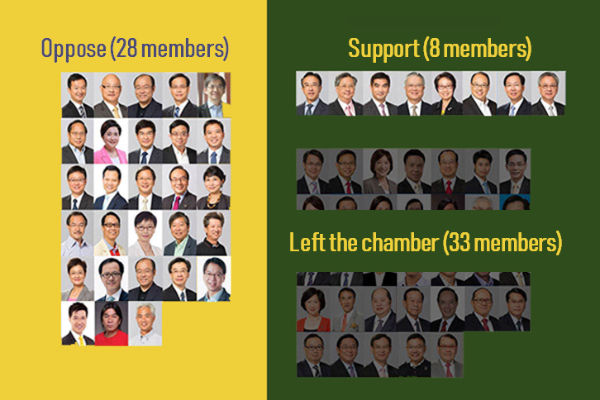
立法機關對行政機關的制衡
Legislature vs Executive
The proposed Hong Kong electoral reform in 2015 has been rejected by the LegCo.

Slide 42
立法機關對行政機關的制衡
Legislature vs Executive
Article 73
The Legislative Council of the Hong Kong Special Administrative Region shall exercise the following powers and functions;
(2) To examine and approve budgets introduced by the government;
(3) To approve taxation and public expenditure;

Slide 43
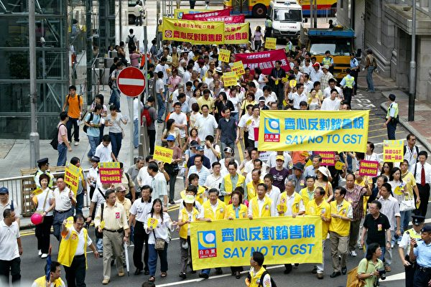
立法機關對行政機關的制衡
Legislature vs Executive
The proposal of Goods and Service Tax has been rejected in 2016

Slide 44
立法機關對行政機關的制衡
Executive VS Legislature
Article 49
If the CE of the HKSAR considered that a bill passed by the LegCo is not compatible with the overall interests of the Region, he or she may return it to the LegCo.
However, if the LegCo passed the original bill again by not less than a two-third majority, CE must sign and promulgate it within 1 month, or act in accordance with the provision of article 50 of this law.

Slide 45
立法機關對行政機關的制衡
? Executive VS Legislature ?
Article 50
The CE could dissolve the LegCo if:
the CE refuse to sign the bill passed the second time by the LegCo; or
the LegCo refuses to pass a budget or any other important bill introduced by the government, and consensus still cannot be reached after consultation

Slide 46
立法機關對行政機關的制衡
? Executive VS legislature ?
Article 74
Members of the Legislative Council of the Hong Kong Special Administrative Region may introduce bills in accordance with the provisions of this Law and legal procedures. Bills which do not relate to public expenditure or political structure or the operation of the government may be introduced individually or jointly by members of the Council.
The written consent of the Chief Executive shall be required before bills relating to government policies are introduced.
The devil is hidden in the details...

Slide 47
立法機關對行政機關的制衡
? Executive VS legislature ?
Changes in Rules of Procedure:
1.Lower the quorum of a committee of the whole council
2.Raise the threshold in submitting a petition
3.Limit the number of amendment proposals
4.Can resume the meeting anytime after adjournment of Council

Slide 48
立法機關對行政機關的制衡
? Legislature VS Executive?
Legislature rejects bid to use special powers to investigate MTR’s Hung Hom construction scandal

Slide 49
立法機關對行政機關的制衡
? Legislature VS Executive?
An electoral officer can disqualify Leung from the election
The Government owns the decision to bar anyone, like Edward Leung, from running.

Slide 50
立法機關對行政機關的制衡
? Legislature VS Executive?
Article 73
The Legislative Council of the Hong Kong Special Administrative Region shall exercise the following powers and functions;
( 3 ) To approve taxation and public expenditure;
( 4 ) To receive and debate the policy addresses of the Chief Executive;

Slide 51
? Legislature VS Executive?
立法機關對行政機關的制衡
Article 74
Members of the Legislative Council of the Hong Kong Special Administrative Region may introduce bills in accordance with the provisions of this Law and legal procedures. Bills which do not relate to public expenditure or political structure or the operation of the government may be introduced individually or jointly by members of the Council.
The written consent of the Chief Executive shall be required before bills relating to government policies are introduced.

Slide 52
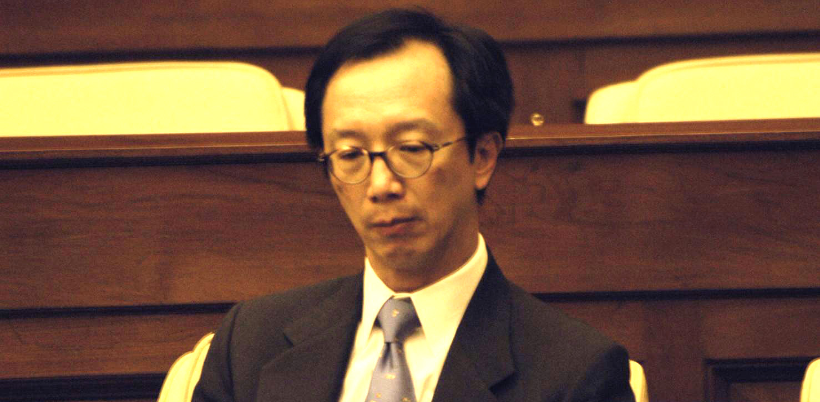
立法機關對行政機關的制衡
Legislature VS Executive
In 2003, Antony Leung Kam-chung, former Financial Secretary, purchased a Lexus before announcing a proposal to sharply increase the first-registration tax on new cars. He was required to be questioned in Legislative Council. He also submitted his resignation at a later stage.

Slide 53
The executive could also
restrict the power of legislature!

Slide 54
立法機關對行政機關的制衡
Executive VS Legislature
Article 49 If the Chief Executive of the Hong Kong Special Administrative Region considers that a bill passed by the Legislative Council is not compatible with the overall interests of the Region, he or she may return it to the Legislative Council within three months for reconsideration. If the Legislative Council passes the original bill again by not less than a two-thirds majority of all the members, the Chief Executive must sign and promulgate it within one month, or act in accordance with the provisions of Article 50 of this Law.

Slide 55
立法機關對行政機關的制衡
Executive VS Legislature
Article 50
If the Chief Executive of the Hong Kong Special Administrative Region refuses to sign a bill passed the second time by the Legislative Council,
or the Legislative Council refuses to pass a budget or any other important bill introduced by the government, and if consensus still cannot be reached after consultations,
The Chief Executive may dissolve the Legislative Council.

Slide 56
Which is the role of the Judiciary?

Slide 57
Judiciary is independent to the other two powers
Article 85
The court of HKSAR shall exercise judicial power independently, free from any interference

Slide 58
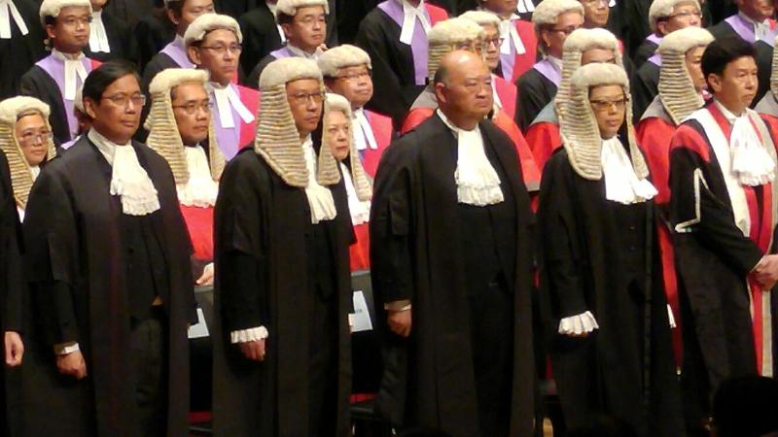
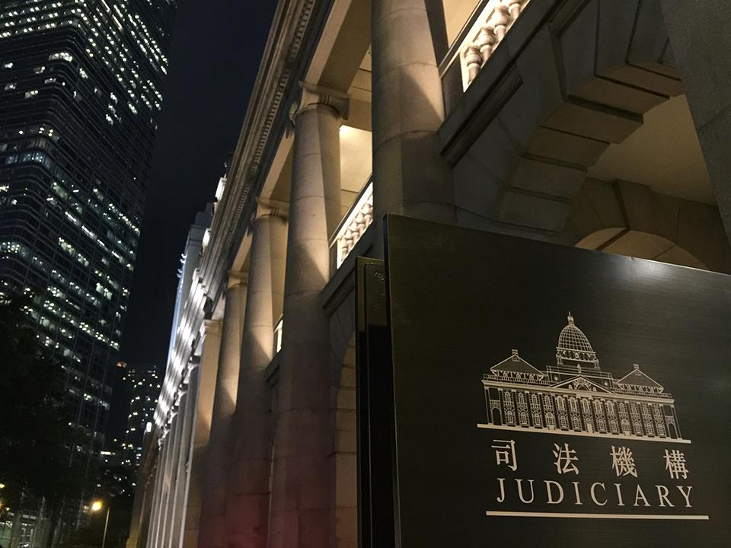
Appointment and Dismissal:
1. Judges are appointed the CE on the recommendation of an independent commission-Article 88
2. A judge may only be removed for inability (e.g. serious sickness) or for misbehaviour, by the Chief Executive on the recommendation of a tribunal appointed by the Chief Justice of the Court of Final Appeal and consisting of not fewer than three local judges-Article 89
3. Endorsement of the Legislative Council shall be obtained if it concerns CFA judges or the Chief Judge of High Court and report to the Standing Committee of the National People's Congress for the record- Article 90

Slide 59
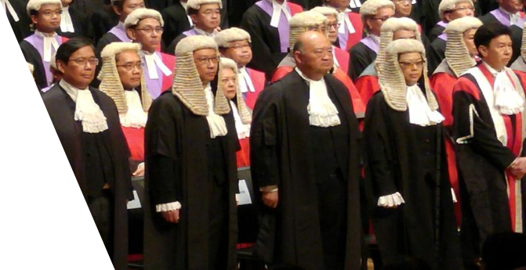

Slide 60
Limitation of power on Executive and legislature by Judiciary
Through Judicial review, the Judiciary could check whether the bills of government are consistent to the constitution, and rule the bills which contravene with Basic law as ineffective.

Slide 61
Limitation of power on Executive and legislature by Judiciary
Some controversial judicial review cases:
Case | Result
Lo Siu Lan v HK Housing Authority (the Link case) | Government won
Queen’s Pier case | Government won
Hong Kong-Zhuhai-Macau Bridge project case | Government’s appeal succeeded
Foreign domestic helpers’ right of abode case | Government’s appeal succeeded
Lung Mei Beach case | Government won
Case of Eligibility criteria of comprehensive Social Security Assistance | Government loss
HKTV free TV license case | Government loss
The Citizen’s Radio case | High court reject the appeal ofthe Citizen’s Radio

Slide 62
Limitation of power on Executive and legislature by Judiciary
High Court rules co-location scheme consistent with Basic Law

Slide 63
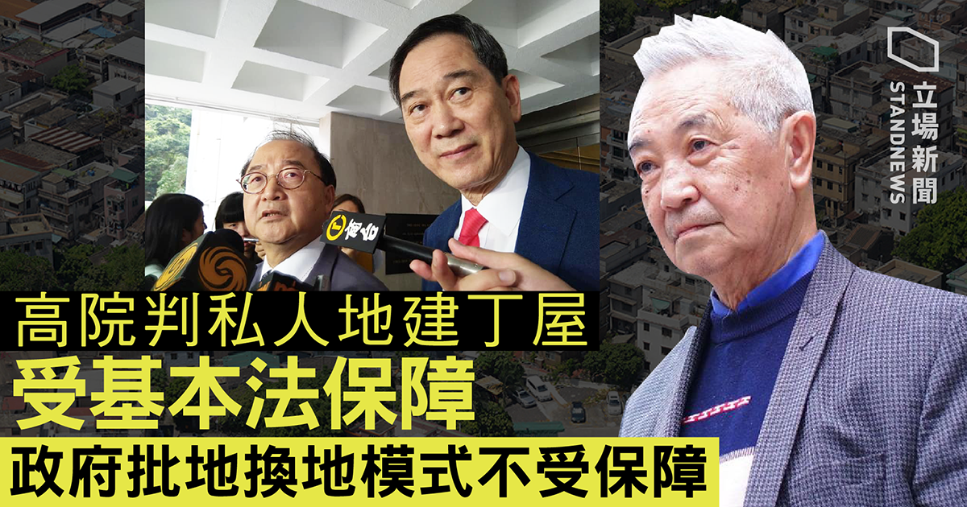
Limitation of power on Executive and Legislature by Judiciary
Hong Kong court partially upholds policy granting special land rights to male villagers

Slide 64
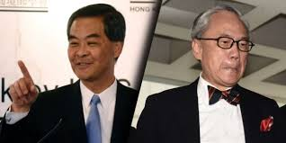
立法機關對行政機關的制衡
? Judicial VS Executive?
Department of Justice (DOJ) would usually seek advice from an independent counsel before making its decision
DOJ had sought independent for Donald Tsang’s case.
However, no independent advice seeked for CY Leung’s case
The bar association warned that any doubts over how the DOJ came to the decision not to prosecute Leung will erode confidence in the criminal justice system and the rule of law.
NO!
YES!
Advice from an independent counsel?

Slide 65
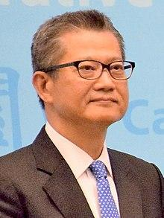
立法機關對行政機關的制衡
? Judicial VS Executive?
Reports in the past few days showed that Chan's wife, Frieda Hui Po-ming, and son had co-owned with others - through a number of companies - 18,000 sq ft of land in Kwu Tung North, which is earmarked as a new town. Chan, as a company director at the time, although not a shareholder, bought the land in 1994, two years before the area was identified for development -> Conflict of Interests
ICAC stopped its investigation without reasonable explanations

Slide 66
Thin definition on Rule of Law
Thick definition on Rule of Law

Slide 67
The more truth is debated the clearer it becomes

Slide 68
Conclusion of separation of powers
Constitution
restriction
Public power
seperation
seperation
seperation
Executive
monitor
Execute
As references of judgements
Enact
law
Check whether the bill is constitutional
Judiciary
Legislature

