Slide 1
Descendants of the “Lawless Village”
Relationship between law obedience and the rule of law

Slide 2
Objective
Understand what is law and the concept of rule of law
Understand the importance of law obedience in safeguarding the rule of law
Discuss the impact of law making on the rule of law
Discuss whether law obedience would necessarily lead to the rule of law

Slide 3
Introduction
Our life is closely connected to the law.
So…what is the law?

Slide 4
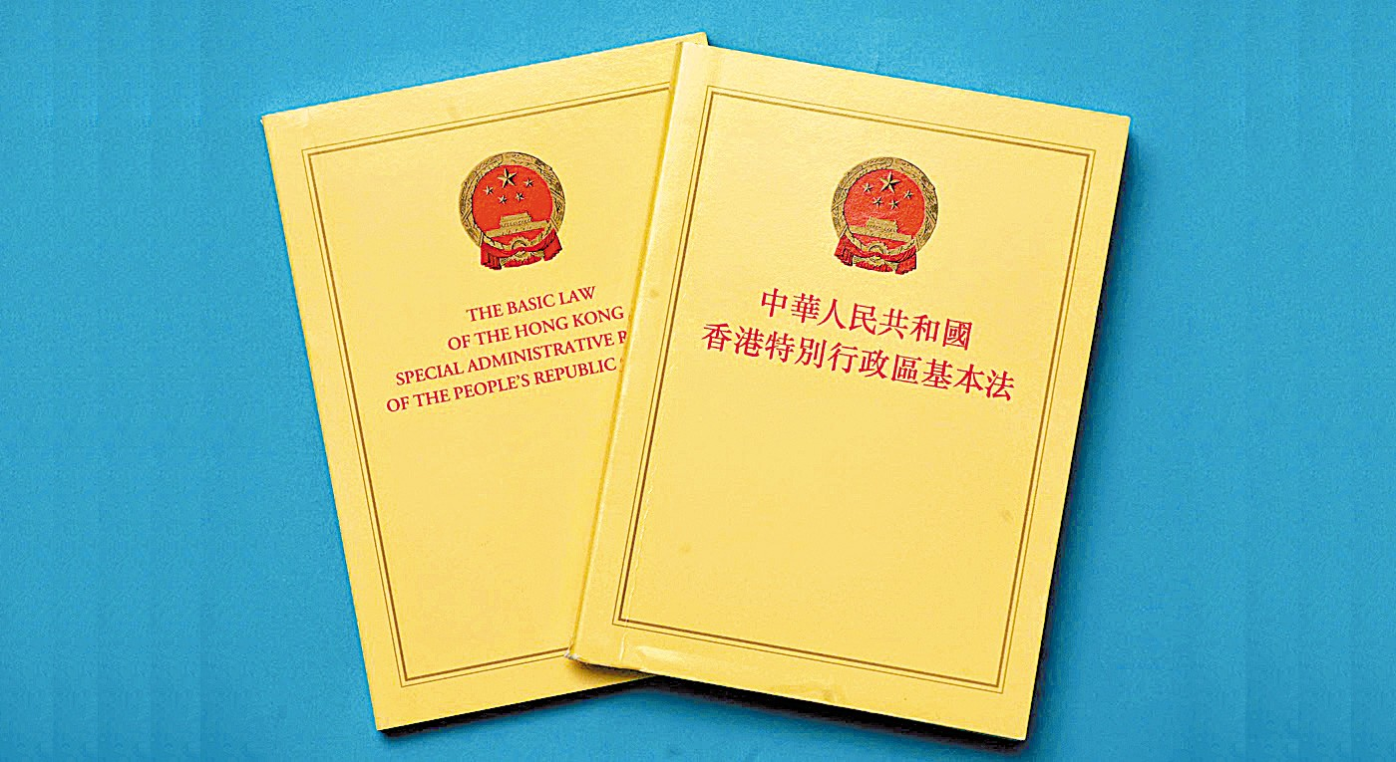
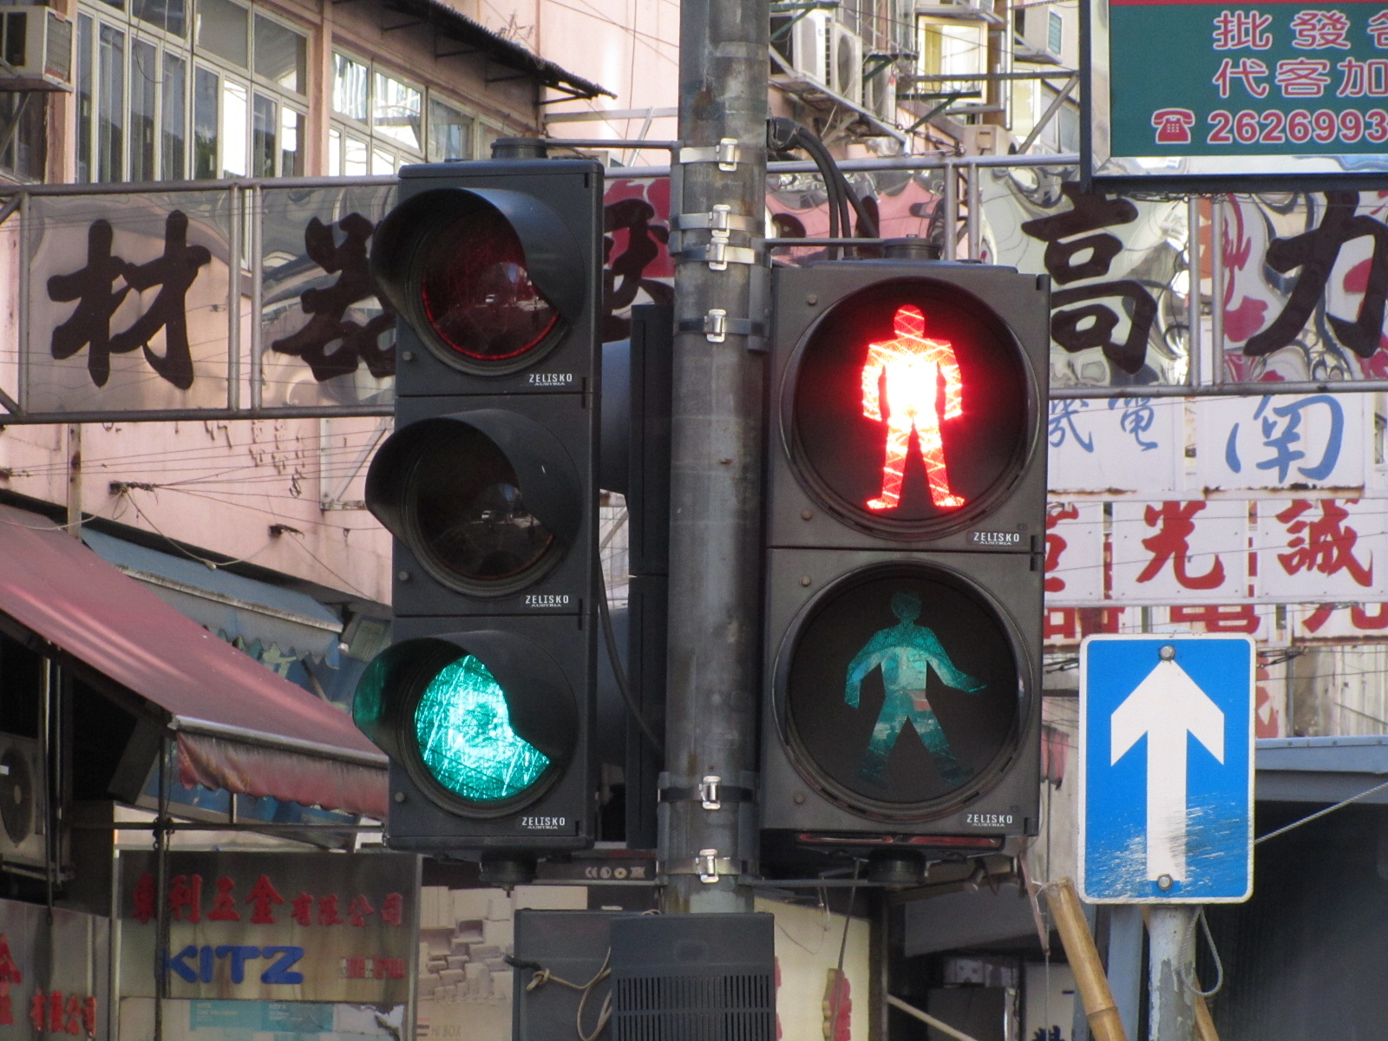
What is law?

Slide 5
Basic Law Article 42
Hong Kong residents and other persons in Hong Kong shall have the obligation to abide by the laws in force in the Hong Kong Special Administrative Region.

Slide 6
The Four Levels of the Rule of Law
Justice
through Law
Limitation from Law
Regulation by Law
Existence of Law

Slide 7
Existence of Law
This is the foundational level.
There must be laws covering major areas of human activities
These laws satisfy some basic requirements.

Slide 8
Regulation by Law
Public order is generally maintained by law.
Citizens in general are willing to comply with the law.
People resolve disputes peacefully
through legal means.
Government uses law as the major governing tool.
Depends on official’s self-discipline

Slide 9
Limitation from Law
Powers are effectively and adequately constrained by a series of external limitation mechanisms including check on executive powers through an independent judiciary to prevent abuse of powers.

Slide 10
Justice through Law
Providing protection to fundamental rights of various kinds can be taken as achieving justice.

Slide 11
Case Study
Do you know why there is law?
Can you explain the relationship between "law" and “rule of law"?

Slide 12
Tale as old as time:
There was a beautiful place called “Lawless Village" ...

Slide 13
The villagers had been living a happy life

Slide 14
Even if there was no regulations or law in the village
There were seldom disputes
Notes:
有咩問題都可以問村長意思 德高望重

Slide 15
If the villagers encountered any problems, they sought judgment from the village Chief.
Notes:
有咩問題都可以問村長意思 德高望重

Slide 16
The Chief was wise and had high reputation among the villagers.

Slide 17
One day, happiness was interrupted…

Slide 18
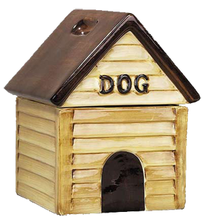
One of John’s dogs was lost. His neighbour Peter ate the dog out of hunger.
?

Slide 19
Q.1
How should John resolve this problem?
Revenge by himself
Seek help from the Village Chief
Pretend that nothing happened

Slide 20
Questions
How should the Chief solve the problem?
What if the same situation happen again?

Slide 21
There is no law at the moment.
But…is it fair?
Why people should listen to the Chief?

Slide 22
What is law?

Slide 23
Elements:
Rule
Issued by authority
Through certain procedure
Made known to the people
Generally applies
Non retrospective

Slide 24
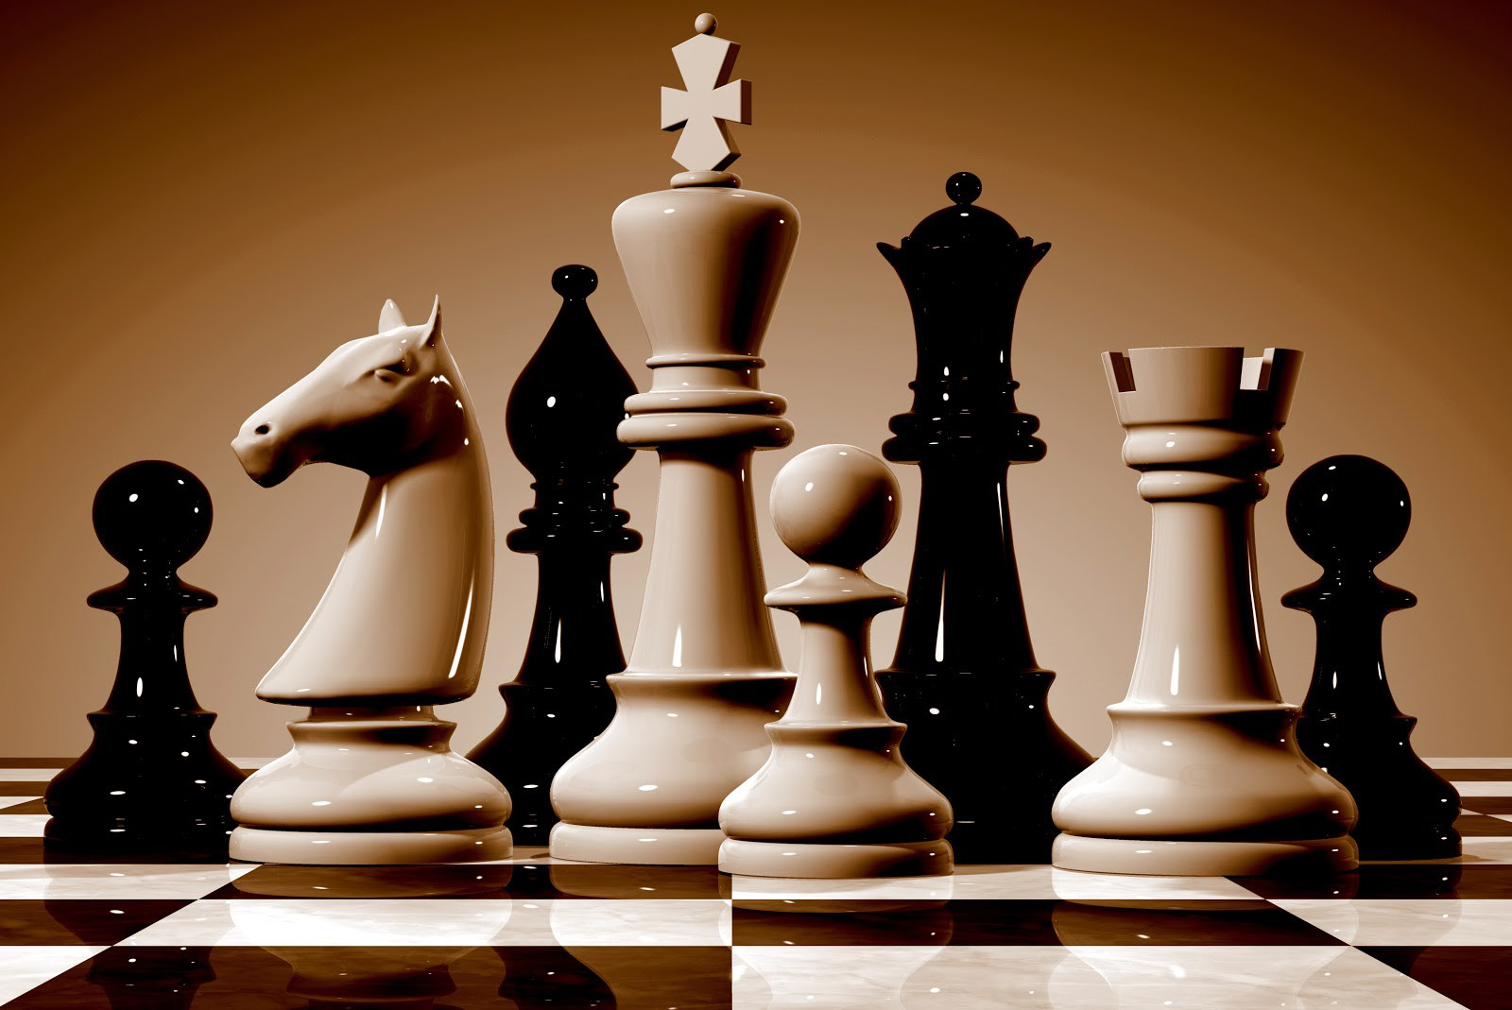
Law? Chess Game Rule?

Slide 25
Elements:
Rule
Issued by authority
Through certain procedure
Made known to the people
Generally applies
Non retrospective
The content concerns…

Slide 26
The Chief decided to make a law against eating dogs
Offenders shall do cleansing for each household
for one month.
He posted this law outside the village office.
Notes:
張貼在村公所

Slide 27
A few days later, Amy saw another dog of John’s...

Slide 28
Q.2(a)
Should Amy eat John’s dog？
Yes
No

Slide 29
Q.2(b)
If Amy ate John’s dog, what should the Chief do?
Sanction Amy to do one-month cleansing for every household
Give her Verbal Warning
No action

Slide 30
Another day…Son of the Chief, Thomas would like to get a taste of dog meat out of curiosity…

Slide 31
Thomas ate John’s another dog!

Slide 32
Q.3
How should the Chief solve the problem?
Require Thomas to do one-month cleansing for every household
Verbal Warning
No action
Notes:
法律面前人人平等，不論社經地位高低都要守法 (公平)

Slide 33
Thomas held a grudge against John after the punishment….

Slide 34
Thomas saw John on his way home⋯⋯

Slide 35
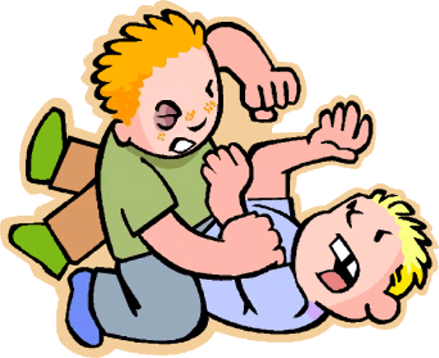
Thomas beated John, and John sufferred serious bodily harm.
Notes:
Retrospective effect?

Slide 36
This incident aroused anger of the whole village…

Slide 37
The Chief decided to set up another law -
Who has inflicted grievous bodily harm shall be liable to imprisonment for 10 years.

Slide 38
Q.4
Why the Chief has to enact this law?

Slide 39
Summary
The village Chief made law to prevent people from dog-eating and battery (beating people up)
The village Chief punished villagers according to law
The law applies to all villagers equally
What is the level of the rule of law in each of the above situations?
Justice
through Law
Limitation from Law
Regulation by Law
Existence of Law

Slide 40
Questions!
Can we achieve the rule of law merely by obeying the law?
How can we achieve higher level of “rule of law”?

Slide 41
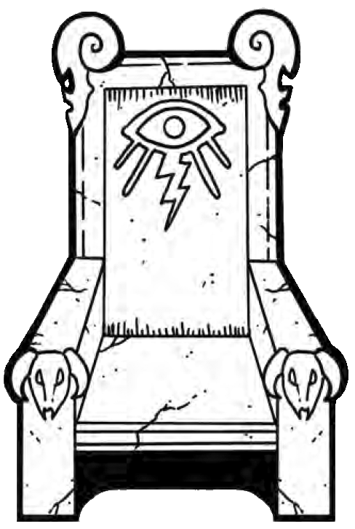
Ten years later, the Chief passed away. According to the village’s custom, Thomas inherited the post from his father.

Slide 42
Thomas always wanted to take over John’s properties for revenge.

Slide 43
So Thomas enacted a new Law – “The Village Chief has power to take over all properties of any villager’s”.
Then Thomas took away John’s crops according to this new law.

Slide 44
Group Discussion
What is revealed in the above scenario?
Under this situation, can law obedience alone achieve the rule of law?

Slide 45
Group discussion
Law as a tool of dictatorship
We could only rely on the Thomas’s self-discipline
Hereditary System
No villagers’ consent to Thomas → He did not need to consider the interests of the villagers when he made laws
Lack of check and balance → People were not able to limit the power of Thomas
Content of the law-
not able to protect fundamental rights of the villager.

Slide 46
Group discussion
How can we solve the problems above?
Constitution (the Basic Law)
List the responsibilities of Village Chief and the basic rights of the villagers (e.g. Private Property Right)
Judicial Independence
Ensure the understanding of the law is correct, impartial judges to decide cases.
Democratic Election System
ensure the content of the law address the interests of the people

Slide 47
After the reform, “Lawless Village” had evolved into “Rule of Law Village”!

Slide 48
Conclusion

Slide 49
Law obedience is important to achieve the rule of law. But rule of law is NOT merely about law obedience.

Slide 50
Thank you!
Q＆A Session

