Slide 1
Contempt of Court
藐視法庭
HKU Faculty of Law
Rule of Law Education Project

Slide 2
Learning Objectives
(1)Freedom of Speech
(2)Contempt of Court and Scandalising the Court
(3)Conflicts between Freedom of Speech and Contempt of Court
(4)Boundary of Contempt of Scandalising the Court
(5)Balance between FoS and Judicial Independence

Slide 3
0
Freedom of Speech
Notes:
人有好多種自由, 言論自由係其中一種

Slide 4
Shall nowadays students learn Classicial Chinese？

Slide 5
The Basic Law Protects Citizens’ Rights
Article 27
Hong Kong residents shall have freedom of speech, of the press and of publication; freedom of association, of assembly, of procession and of demonstration; and the right and freedom to form and join trade unions, and to strike.

Slide 6
Freedom of Speech
“
”
I disapprove of what you say,
but I will defend to the death your right to say it.
—— The Friends of Voltaire
British Writer Evelyn Beatrice Hall

Slide 7
Importance of Freedom of Speech
Discover the Truth
For Self Actualization
Support democracy

Slide 8
Importance of Freedom of Speech
Discover the Truth
Heliocentrism
Geocentrism
Notes:
有助於發現真理
為了發現真理，必須允許人們自由地思想和言論，因為只有這樣，才能將各種事實和觀點呈現出來。每個人都會犯錯，只有讓人們進行自由表達和交流，才能發現和改正錯誤，獲致真理。

Slide 9
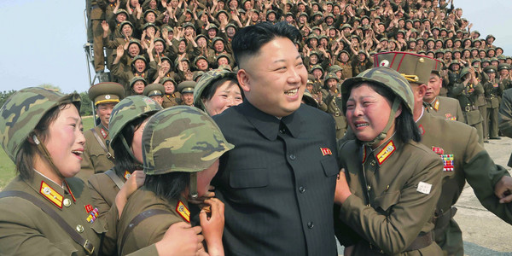
Importance of Freedom of Speech
Discover the Truth
Notes:
有助於發現真理
為了發現真理，必須允許人們自由地思想和言論，因為只有這樣，才能將各種事實和觀點呈現出來。每個人都會犯錯，只有讓人們進行自由表達和交流，才能發現和改正錯誤，獲致真理。

Slide 10
Importance of Freedom of Speech
Discover the Truth
For Self Actualization
Support democracy

Slide 11
Importance of Freedom of Speech
2. For Self-Actualization
Express yourself creatively
Notes:
有助於個人自我實現
人存在的目的是實現自己的個性與潛能，每個人在發展自己的個性時，離不開對自己信念和觀點的表達，因為表達是觀念和心智發展不可分割的一部分，壓制信念、觀點及表達就是對人的尊嚴和人性的否定。

Slide 12
Importance of Freedom of Speech
Discover the Truth
For Self Actualization
Support Democracy

Slide 13
言論自由的重要性
Your suggestions on our policies/ services would be most welcome
The government has hundreds of billions. How come the medical resources are still scarce?
Great Job!

Slide 14
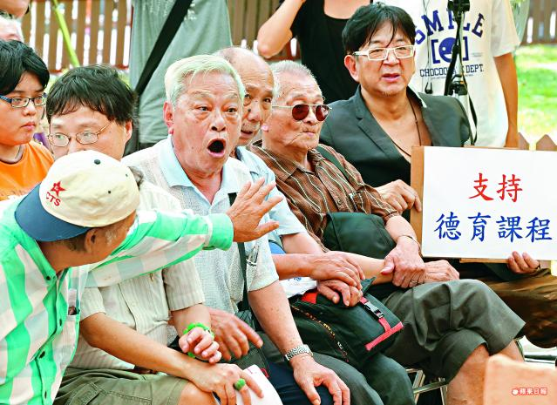

Slide 15
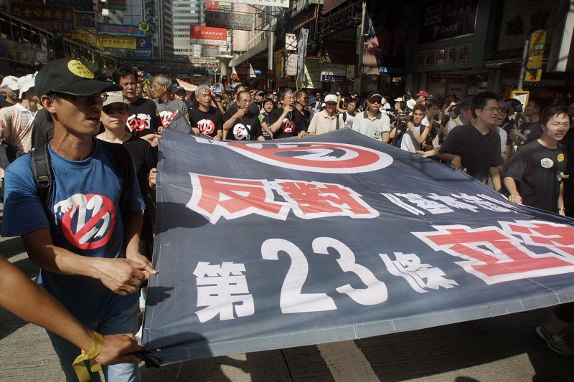

Slide 16
Is Freedom of Speech Absolute?
《Hong Kong Bill of Rights Ordinance》Article 16
Freedom of Opinion and Expression
(1)Everyone shall have the right to hold opinions without interference.
(2)Everyone shall have the right to freedom of expression; this right shall include freedom to seek, receive and impart information and ideas of all kinds, regardless of frontiers, either orally, in writing or in print, in the form of art, or through any other media of his choice.
(3)The exercise of the rights provided for in paragraph (2) of this article carries with it special duties and responsibilities. It may therefore be subject to certain restrictions, but these shall only be such as are provided by law and are necessary—
(a)for respect of the rights or reputations of others; or
(b)for the protection of national security or of public order (ordre public), or of public health or morals.
— c.f.《International Covenant on Civil and Political Rights》Art. 19

Slide 17
Appropriate to say/ behave like this in the court？Illegal？Permissible by law？
Bribed to make this judgment.
Roll your eyes at judges?
Behave disorderly and rowdy?
“Char Siu” can judge better than you!

Slide 18
1
What is Contempt of Court?

Slide 19
Two general categorisations of contempt of court
Scandalising the Court
a. Conduct that disrupts the court process itself
Obstructing or interfering with the due course of justice or the lawful process of the Courts
b. Acts that risk prejudicing or interfering with current/ pending legal proceedings
c. Disobedience of court order orders as well as breach of undertakings given to the court

Slide 20
Contempt of Court
Scandalising the
Court
Obstructing/Interfering with legal process
a. Disrupting legal proceedings
b. Affecting impartial judgements
c. Disobey court orders

Slide 21
2
Scandalising the Court
—one of the category
阻礙/干預司法程序
b. 影響公正裁決
阻礙/干預司法程序
c. 違反法庭命令

Slide 22
High Standard of Proof in Scandalising the Court
However....
as it is a high standard of proof for scandalising a court or judge
the court apply this law with considerable care

Slide 23
All criminal offences......
vs
Presumption of Innocence
Presumption of Guilt
Burden of proof (The prosecution)
Standard of proof
Presumption of Innocence
Prove beyond reasonable doubt
Defendant is guilty!
Defendant is protected by the principle of presumption of innocence
Notes:
舉證標準：排除合理懷疑 VS 衡量各方的可能性

Slide 24
All criminal offences......
actus reus
(actions)
mens rea
(mentality)

Slide 25
Example:
Theft
actus reus
appropriates property belonging to another
dishonestly appropriates property belonging to another
with the intention of permanently depriving the other of the property
mens rea
Notes:
第210章 《盜竊罪條例》第 2-8條

Slide 26
Example:
Murder
actus reus
unlawful killing of a human being
intention to kill or
intention to cause grievous bodily harm (GBH)
mens rea
Notes:
第212章《侵害人身罪條例》第2條
http://e-lawresources.co.uk/The-law-of-murder.php

Slide 27
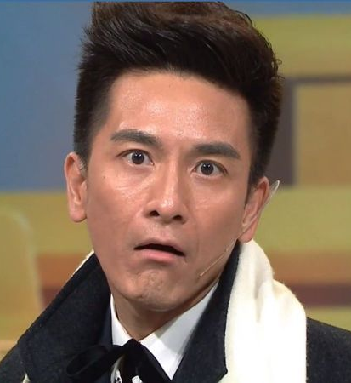
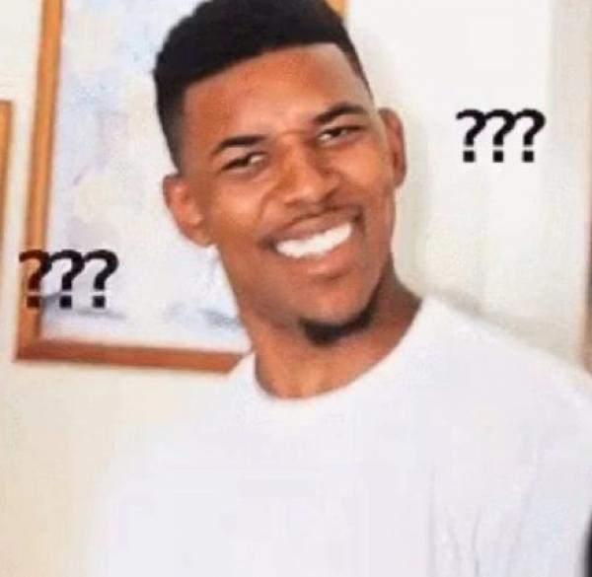
How to prove mens rea/ actus reus?

Slide 28
How to prove scandalising the court?
mens rea:
An intention to interfere with the administration of justice (or recklessness by appreciation this possible consequence and ignoring it).
Wong Yeung Ng v Secretary of Justice
Wong Yeung Ng v Secretary of Justice

Slide 29
mens rea
The intention is to interfere the administration of justice, e.g. lower the public confidence or reputation of the court
Foresee that there is a real and substantial risk of interference but ignore the risk

Slide 30
How to prove scandalising the court?
actus reus:
The statement (or conduct) was calculated to interfere with the administration of justice - that it involved a ‘real risk’
Wong Yeung Ng v Secretary of Justice

Slide 31
How to prove scandalising the court?
actus reus:
To prove there was a real risk, the Court may consider several relevant factors in making this determination ( on a case-by-case basis). For instance:
Whether the statements were published,
Timing of publication,
Size of the audience and
The likely nature, impact, and duration of their influence
Wong Yeung Ng v Secretary of Justice

Slide 32
Prove Actus Reus
Example: The Oriental Daily News (1997)
Background: The Oriental Daily News (ODN) was angry at the Obscene Articles Tribunal. Because the tribunal ruled that one of the ODN’s publication was Class II indecent article. The ODN cursed the judges on its subsequent publications with a series of abusive and scurrilous attacks.

Slide 33
Prove Actus Reus
Example: The Oriental Daily News (1997)
In considering several relevant factors to prove the Actus Reus
Several relevant factors | Facts
Whether the statements were published | A series of abusive and scurrilous attack over the course of three months
Size of the audience | The Oriental Daily News was a highly popular daily newspaper in Hong Kong with 2.3 million readers
The likely nature, impact, and duration of their influence | The attacks were against the Obscene Articles Tribunal, several named judges and the Judiciary at large. The attacks ultimately culminated in a round-the-clock pursuit of a judge over three days

Slide 34
Prove Actus Reus
Example: The Oriental Daily News (1997)
Conviction:
Convicted of scandalising the court and fined HK$ 5 million
In considering several relevant factors to prove the Actus Reus
Several relevant factors | Facts
Whether the statements were published | A series of abusive and scurrilous attack over the course of three months
Size of the audience | The Oriental Daily News was a highly popular daily newspaper in Hong Kong with 2.3 million readers
The likely nature, impact, and duration of their influence | The attacks were against the Obscene Articles Tribunal, several named judges and the Judiciary at large. The attacks ultimately culminated in a round-the-clock pursuit of a judge over three days

Slide 35
證明 Actus Reus 行動
Example: The Oriental Daily News (1997)
Background: The Oriental Daily News defied Obscene Articles Tribunal adjudication of adjudicating its publication as Class II indecent article, and cursed to the judges on its newspaper with a series of abusive and scurrilous attacks.
刑罰:
中傷法庭罪罪成，
被罰款500萬
Several relevant factors to prove Actus Reus
Several relevant factors | 實際情況
有關中傷言語是否公開並有機會受社會廣泛輿論 | 東方報業是香港受歡迎，為人熟知的刊物 (約230萬讀者)
有多少人會看到相關中傷言語 | 一連串有關惡意中傷，帶有侮辱性的言論刊登了超過三個月
中傷言語對有關人士的影響程度 | 連名帶性地針對個別法官作出侮辱、中傷

Slide 36
Cases Study

Slide 37
Case Study 1
Mr A supports the Umbrella Movement (the Occupy Central Movement)
He watched the court hearing of the Mong Kok civil unrest,‘Fishball Revolution’ in 2016
Later he posted the following sentences on social media
“If one who joined the unrest but in fact had hurt no one was jailed for 3 years, then was it reasonable for jailing the 7 policemen for only two years that they were caught beating an activist in the dark corner? Was it too light?”

Slide 38
Is Mr A’s online statement a contempt of court? Is there any reasonable doubt?
Actus reus | Mens rea

Slide 39
Mr A’s online statement is not a contempt of court
Actus reus | Mens rea
It was criticism instead of vicious insult Fair and reasonable | No intention or recklessness to interfere with the administration of justice

Slide 40
Case Study 2
Prosecutor ruled that Ms B was guilty of shoplifting
Ms B’s appeal was rejected
She then made a post on LIHKG saying: “the judge is an idiot and every staff of the Hong Kong Customs and Excise Department (C&ED) were a useless dog.” In her post, she mentioned that C&ED was backed by some British Gwai Lo, including judges Mr Lo and the Mr Ko.
She then made several posts repeating the similar message.
In one of her latest post, she urged that judges should be careful to avoid making any mistakes and thus hitting the headline. Besides, she wished the judges could stay safe and sleep tight every night.

Slide 41
Is Ms B’s statement scandalising the court?
Yes | No
Actus reus | Actus reus
Mens rea | Mens rea
Notes:
(課堂活動 (大概15-20分鐘) *或由同學討論後派代表於白/黑版寫上、並讓他們解釋自己的答案*）

Slide 42
Is Ms B’s statement scandalising the court? Any more evidence you would need?
Think further...
Actus reus - Did she interfere with the administration of justice or amount to a “real risk”? Did it involve many others? When was the relevant statement made? How strong the influence of relevant statement would be over the court?
Mens rea – Did she intentionally or reckelessly interfere with the administration of justice? What was her aim or purpose? Did she foresee the risk and ignore the risk?
Notes:
(課堂活動 (大概15-20分鐘) *或由同學討論後派代表於白/黑版寫上、並讓他們解釋自己的答案*）

Slide 43
Is Ms B’s statement scandalising the court?
Yes
Actus reus-interfere with the administration of justice or amount to a “real risk” Her statement accused judges of incompetent and failing to make decisions for justice, which may harm the court’s reputation Her posts would exist on the Internet forever unless being removed and can be viewed by netizens at all times, which is far more influential than publishing it on the newspaper She had made several consecutive posts
Mens rea-intentionally or reckelessly interfere with the administration of justice Given her consecutive posts, it is evident that she had a clear intent to spread to the public a message that judges were biased and the court was against the justice instead of upholding it. Clearly, it interfere with the administration of judicial process and undermined the authority of the courts. It is more than a reasonable expression of feelings.

Slide 44
Is there any reasonable doubt?
No
Actus reus- no interference with the administration of justice or amount to a “real risk” The content of her post was unclear as there were several judges with the surname Lo or Ko The view rate of her posts were extremely low and the access to some of the posts were restricted to one or two friends only Her posts were created after the ruling was given, it can never cause any risk of affecting the judgment
Mens rea-no intention or recklessness to interfere with the administration of justice Simply an expression of her feelings She knew well that she could never change the judgment and would accept punishment
Notes:
(課堂活動 (大概15-20分鐘) *或由同學討論後派代表於白/黑版寫上、並讓他們解釋自己的答案*）

Slide 45
3
The conflict between scandalising the court and freedom of speech

Slide 46
Revision: the importance of freedom of speech
It helps discover the truth
It helps one to realize his/her full potentials(self-actualization)
It promotes democracy
Notes:
有助於發現真理
為了發現真理，必須允許人們自由地思想和言論，因為只有這樣，才能將各種事實和觀點呈現出來。每個人都會犯錯，只有讓人們進行自由表達和交流，才能發現和改正錯誤，獲致真理。
有助於個人自我實現
人存在的目的是實現自己的個性與潛能，每個人在發展自己的個性時，離不開對自己信念和觀點的表達，因為表達是觀念和心智發展不可分割的一部分，壓制信念、觀點及表達就是對人的尊嚴和人性的否定。
有助於民主政制的有效運作
言論自由有助於政治參與和公共決策。民主意味着自治，意味着廣泛的政治參與，意味着民眾能夠決定或者影響公共政策，而這要求他們能夠表達自己的看法和見解，能夠對公共事務發表意見。
言論自由有助於維持社會穩固與變遷之間的平衡，防止暴力革命的發生。言論自由給人們提供表達不同看法並形成理性判斷的機會，讓人們學會說理及接受自己不贊成的決策。

Slide 47
Scandalising the court
Freedom of speech
Conflict???
Notes:
問同學問題

Slide 48
Is freedom of speech subject to any restrictions?
CAP 383 HONG KONG BILL OF RIGHTS ORDINANCE Section 8 Hong Kong Bill of Rights
Article 16
Freedom of opinion and expression
3)The exercise of the rights provided for in paragraph (2) of this article carries with it special duties and responsibilities. It may therefore be subject to certain restrictions, but these shall only be such as are provided by law and are necessary—
(a)for respect of the rights or reputations of others; or
(b)for the protection of national security or of public order (ordre public), or of public health or morals
—— cf. ICCPR Art.19

Slide 49
Why is scandalising the court prohibited?
「Confidence in our legal system, the maintenance of the rule of law and the authority of the court are matters of special importance in our society. There are frequent, if misconceived, expressions of anxiety in this respect. There is reason to believe that the ordinary citizen in Hong Kong regards the court as his ultimate and sure refuge from injustice and oppression.」
---- Wong Yeung Ng v The Secretary for Justice

Slide 50
Why is scandalising the court prohibited?
Undermines the authority of the courts
Citizens distrust the court
Citizens refuse to accept court’s rulings
Undermines Hong Kong’s rule of law

Slide 51
Why is there no Scandialising of the Chief Executive? Is this fair?

Slide 52
Why is there no Scandialising of the Chief Executive? Is this fair?
How does the executive branch gain their legitimacy:
Listen and respond to the public. Formulate policies based on public opinion and demand
-------------------------------------------------------------
行政，立法並非獨立於民眾
確保政策能切合市民需要
The executive branch is responsible for making sure that the policies are made in the interest of public

Slide 53
Why is there no Scandialising of the Chief Executive? Is this fair?
The source of legitimacy of the court:
Independent and impartial
Judge according to law but not public opinion
Limit the powers of other government branches, prevent abuse of power, ensure fair procedure and therefore safeguard the rights of citizens

Slide 54
Why isn’t there an offence called “Scandialising of the Chief Executive”? Is it fair?
The judiciary’s source of legitimacy:
The cornerstone of rule of law
To ensure that the judiciary can balance the powers of the legislative and executive branches, prevent the abuse of power and safeguard the rights of citizens
-------------------------------------------------------------
The importance of judicial independence:
NOT to safeguard the dignity of individual judges or care about their feelings
But to...
Ensure the smooth operation of courts and prevent extra-legal intervention
The legislative and executive branches’ source of legitimacy:
Responding to citizens’ demands, listening to their opinions and implementing relevant policies
-------------------------------------------------------------
The legislative and executive branches aren’t independent from public opinion:
Ensuring policies implemented can meet to citizens’ needs
The SoC offence can protect judicial independence

Slide 55
The Freedom of Speech and Judicial Independence
1. Only with an independent judiciary
will citizens’ rights and freedom be safeguarded

Slide 56
The Freedom of Speech and Judicial Independence
1. Only with an independent judiciary
will citizens’ rights and freedom be safeguarded
2. To ensure the fair operation of courts and insulate judges from public opinion
An appropriate limitation on citizens’ freedom of speech is required to safeguard judicial independence
Encouraging rational discussion instead of irrational rants

Slide 57
The Freedom of Speech and Judicial Independence
1. Only with an independent judiciary
will citizens’ rights and freedom be safeguarded
2. To ensure the smooth operation of courts and insulate judges from public opinion
An appropriate limitation on citizens’ freedom of speech is required to safeguard judicial independence
Encouraging rational discussion instead of irrational rants
The SoC Offense is needed

Slide 58
4
The Boundaries of Scadalising the Court

Slide 59
Chilling Effect?!

Slide 60
Contempt of
Court
Actus Reus
Real risk of interfering with administration of justice
Mens Rea
intentionally (or recklessly)
Burden of proof on the prosecutor to prove beyond reasonable doubt

Slide 61
What is the purpose of law?

Slide 62
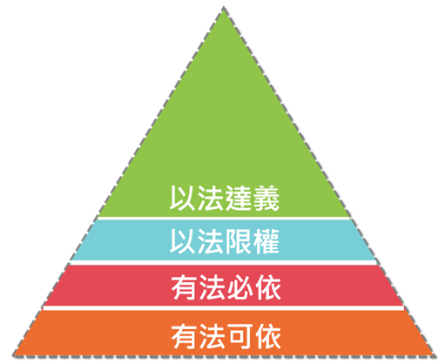
Four Levels of Rule of Law
Justice through Law
Limitation from Law
Regulation by Law
Existence of Law

Slide 63
Four Levels of Rule of Law
The fourth level - Justice through law
Safeguard human rights
E.g. freedom of speech
Safeguard rights of election
Protection the disadvantaged in society
Justice through Law

Slide 64
The ultimate purpose of law is to safeguard human rights

Slide 65
5
Summary

Slide 66
Contempt of Court
Scandalising the
Court
Obstructing/Interfering with legal process
a. Disrupting legal proceedings
b. Affecting impartial judgements
c. Failure to satisfy court orders

Slide 67
Contempt of
Court
Actus Reus
Real risk of interfering with administration of justice
Mens Rea
intentionally (or recklessly)
Burden of proof on the prosecutor to prove beyond reasonable doubt

Slide 68
Scandalising the
Court
Freedom of Speech
Judicial Independence

Slide 69
Justice through Law
Scandalising the
Court
Freedom of Speech
Judicial Independence

Slide 70
Thank You!

Slide 71
Questions??

Slide 72
Useful Resources
https://www.thestandnews.com/politics/%E5%B0%B1%E8%A8%80%E8%AB%96%E8%87%AA%E7%94%B1%E5%8F%8A%E6%83%A1%E6%84%8F%E4%B8%AD%E5%82%B7%E6%B3%95%E5%BA%AD%E4%BA%8B%E5%AE%9C%E6%8F%90%E4%BA%A4%E7%9A%84%E6%84%8F%E8%A6%8B%E6%9B%B8/
https://www.info.gov.hk/gia/general/200602/21/P200602210092.htm
http://petertsangwc.blogspot.com/2014/03/98.html
https://books.google.com.hk/books?id=ZQ0fAwAAQBAJ&pg=PA135&lpg=PA135&dq=黃陽午對律政司司長&source=bl&ots=yYgO-EZNna&

Slide 73
HKU Law Programmes for JUPAS applicants (The knowledge and skills we learn are relevant in any field)
HKU
Years
Intake
Selection
Faculty
LLB
4 yrs
95-100
DSE only
Law
BA Literary Studies & Law
5 yrs
25
DSE only
Law
BBA(Law)
5 yrs
70-80
Also Interview
Business
BSS(GL)
5 yrs
60-70
Maybe Interview
Soc Sci

Slide 74
2018-19 Average JUPAS (HKDSE) Results (5**=7; 5*=6; 5=5; 4=4; 3=3; 2=2; 1=1)
HKU | English | Chinese | Maths | Liberal Studies | 4 core subjects & best 2 electives
LLB | 6.133 | 5.649 | 5.253 | 5.667 | 5.772
BA(Literary Studies)/LLB | 6.056 | 5.944 | 5.444 | 5.667 | 5.815
BBA(Law)/LLB | 6.222 | 5.847 | 5.819 | 6.125 | 6.086
BSS(GL)/LLB | 6.275 | 5.922 | 5.353 | 6.020 | 5.918
Law School A (LLB) | 6.000 | 5.444 | 4.689 | 5.511 | 5.389
Law School B (LLB) | 5.667 | 4.373 | 4.529 | 4.647 | 4.811

Slide 75
Strategy for JUPAS (HKDSE) Applicants (Apply for Law whether you want to be a lawyer or not)
The JUPAS system will send you to the FIRST programme that you meet its criteria
E.g. 4C+2E = 42
1st choice
2nd choice
3rd choice
JUPAS outcome
Science
Law
Medic
Science
(You won’t go to 2nd/3rd choice even if you also meet their criteria)
● If your 4C+2E = 34 or above, good chance of getting into Law
● Actual minimum varies from year to year, around 33 or 34
● When you re-prioritize, put us as FIRST choice

